Slide 1
2019 – 2020
Committee Training:
Competition Funding & SU Events
Register your attendance here:
https://umabersu.wufoo.com/forms/registration/

Slide 2
National Competition Funding
We will fund ONE competition per year for Clubs (and Societies where relevant)
Entry cost (either 1 team, or 10 individuals)
Travel cost (minibus hire and fuel)
NO other expenses, e.g. Accommodation, food, etc.
You will need to organise your own transport/let us know you require it
Please notify the Opportunities Office prior to entering with breakdown of costs
We will usually accept your funding request (if budgeted for)
by next working day

Slide 3
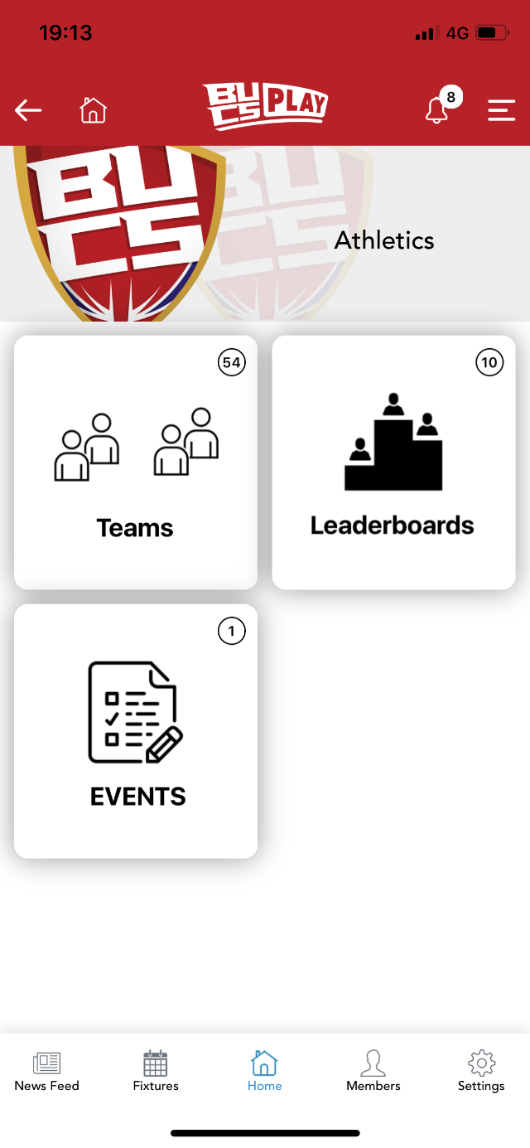
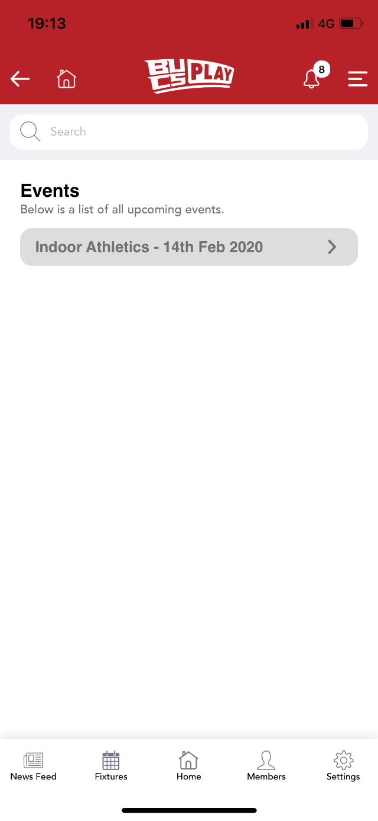
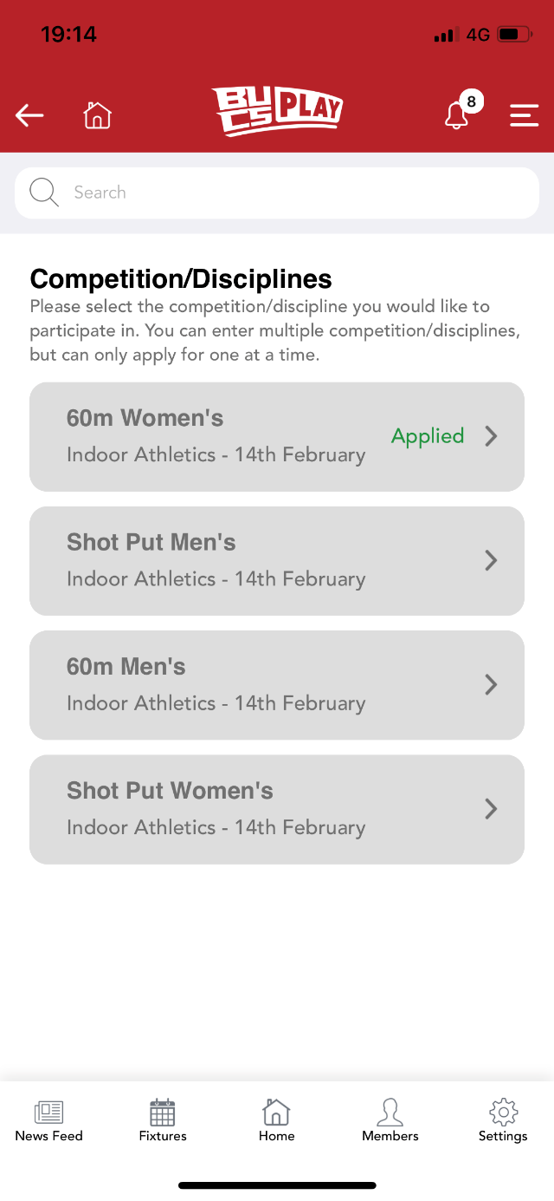
BUCS Competitions
Each competitor to register an account
Enter the sport they wish to enter
Click on the events tile
Select their event from the list
Find their discipline

Slide 4
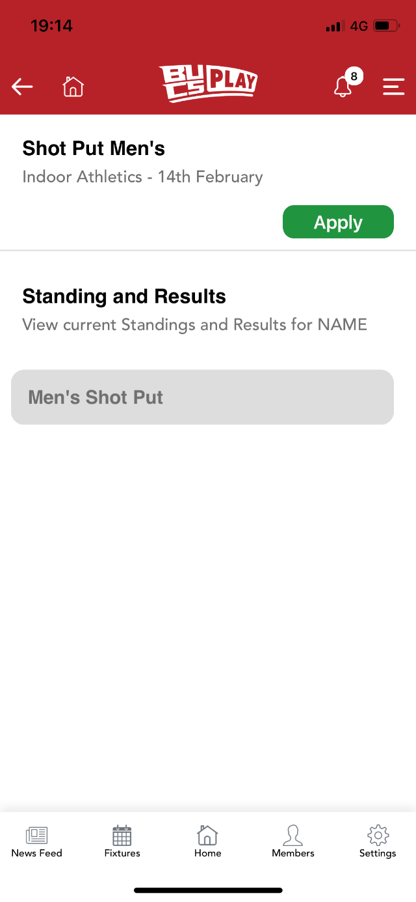
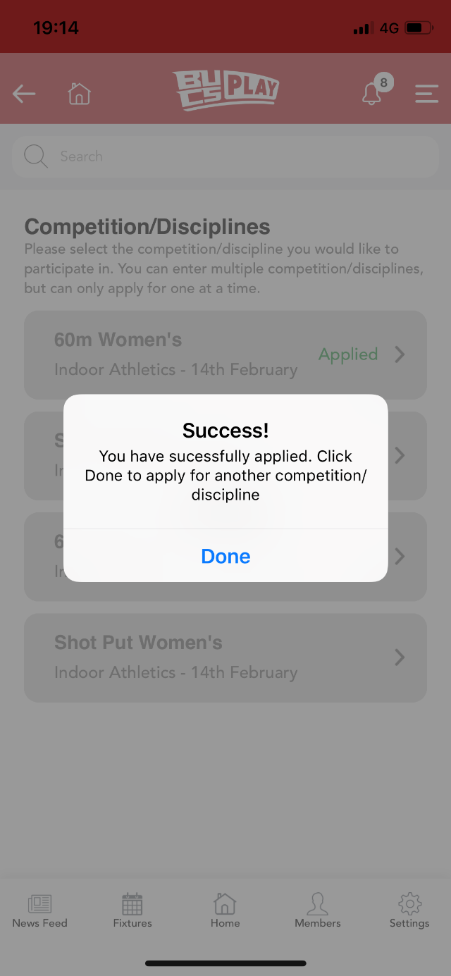
Click Apply & enter the discipline specific information
Captain to email Lucie to confirm all competitors have submitted entries; as well as ranking list/guaranteed or non-guaranteed
Lucie will accept entries and confirm with BUCS
The SU will arrange payment etc.

Slide 5
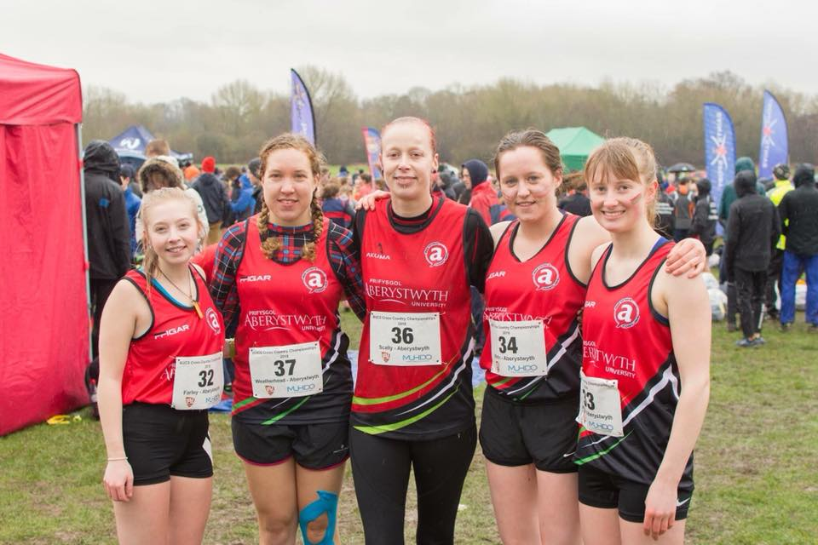
Non-BUCS Competitions
You will need to enter these yourselves on behalf of your Club or Society
You can request an invoice from the Event Organiser/NGB for the SU to pay directly, or pay yourselves and be later reimbursed

Slide 6
Feedback
Please let us know how you get on at these events
Send us reports, results, photos, etc. and we will publish as News Stories on our website and share on our social media channels
Email suopportunities@aber.ac.uk with your results

Slide 7
SU Events
Homecoming 02.11.2019
Aber Challenge *NEW* 08 – 10.11.2019
Superteams Women’s 14 – 16.02.2020 | Men’s 21 – 23.02.2020
Varsity 21.03.2020
SocietiesFest *NEW* 21.03.2020
AberSU Celebrates (Awards) Societies 28.04.2020 | Sports 29.04.2020
Aber7s 02 – 03.05.2020

Slide 8
Homecoming
Saturday 2nd November 2019
Alumni event – those involved have been emailed with the timetable
Funded by Alumni Office (AberFund)
SU will advertise; clubs / socs to lead their own activity and invite their own alumni
See up to date website information here

Slide 9
Aber Challenge
Fri 8th, Sat 9th & Sun 10th November
Teams of 5 (opportunity to enter as individuals and teams will be made up for them)
£50 per team / £10 per individual
Events include: Quiz, Tower Construction, Beer Pong, Boob Ball, Scategories, Scavenger Hunt, Beach Clean, E-Sports, Texas Poker
1 event can be dropped / 1 jokered
Entry opens 12pm 2nd October | Deadline 12pm 23rd October
Requirements: Current student at AU and holds Team Aber Insurance
See up to date website information here

Slide 10
Superteams
Women’s 14 – 16th February | Men’s 21 – 23rd February 2020
Team Registration 9am on Friday 13th December 2019
£195 per team (£19.50 per person)
56 teams of 10 (28 women’s, 28 men’s)
Events include: Swimming, Waterpolo, Bleep Test, Tug of War, Basketball, Dodgeball, Football, Gym Test, Relay, Campus Mile, Mystery Event (1 event can be dropped / 1 jokered)
Requirements: Current student at AU and holds Team Aber Insurance
See up to date website information here
*Good practice for Team Entry*

Slide 11
Varsity
Saturday 21st March 2020 in Bangor
Clubs will need to express interest to compete by Friday 15th November 2019
Competitor & Spectator Packs will be available to pre order in January, and collect end Feb/early March
Competitor Packs £25
Spectator Packs £10
See up to date website information here

Slide 12
SocietiesFest
Saturday 21st March 2020 in Bangor
Networking style: an opportunity to meet and feedback with your counterparts in Bangor
Societies will need to express interest to participate by Friday 15th November 2019
Website page with more information will be created soon!

Slide 13
Celebrates (Awards)
Nominations open 1st January and ends 1st March 2020 | Shortlist announced end March/early April
Societies - Tuesday 28th April 2020
Tickets available to purchase online / SU reception from Monday 23rd March 2020
Venue: TBC | Expected Ticket Price: £20.00
Sports - Wednesday 29th April 2020
Tickets available to purchase from SU reception Monday 6th April 2020
Venue: Brynrodyn Park | Ticket price: £30.00
5 priority tickets per club for first 2 days of sale (remaining tickets go on general sale)
See up to date website information for Celebrates Week here

Slide 14
Aber7s
Saturday 2nd – Sunday 3rd May 2020 on Blaendolau Fields
Team entry opens 9am Friday 6th December 2019
Premier League / Intermediate / Beginners / Women’s
Cost is £290 per team, or early bird price of £260 if purchased before 9am Friday 31st January 2020
See up to date website information here

Slide 15
Questions?
Register your attendance here:
https://umabersu.wufoo.com/forms/registration/

