Slide 1
Intro to
AberSU for staff

Slide 2
Contents:
Welcome
Meet the team – Staff
Meet the Team - Officers
Strategy
Decision making
Political Policies
An average year
Key channels and events
Booking rooms
Benchmarks and awards
Questions

Slide 3
WELCOME
All students at Aberystwyth University are automatically a member of AberSU.
We provide students with a range of benefits and opportunities to get involved in, including:
Helping students to meet new people, make friends and build communities
Supporting and developing student Sport Clubs and Societies
Supporting, training and working with Academic Reps to have a positive impact for students at course level
Free, impartial, friendly and confidential advice
A representative voice for all Aberystwyth University students
Opportunities for students to campaign on the issues they care about
Spaces to study, meet and socialise
We are a democratic, charitable organisation (registered charity) and have a responsibility to act ethically and responsibly in all that we do, contributing to the wider community and limiting our impact on the environment.

Slide 4
MEET THE TEAM: STAFF
Key departments:
Student Voice
Student
Opportunities
Communications &
Engagement
FT & Vol Officers
Campaigns
Consultation
Elections
Decision making
Societies & Sports team (BUCS) development and support
Superteams, Aber7s, Varsity
Aber Challenge, Coaching and development
Volunteering inc A-Team
Website & Social media
Marketing income
Brand guidelines
Public relations
Event support
Insight
Translation
Research
People & Wellbeing
Advice Service | HR & staff
Plus Finance & Leadership
Includes Reception, maintenance

Slide 5
MEET THE TEAM: STAFF
How many staff do you think the SU has?

Slide 6
MEET THE TEAM: STAFF
How many staff do you think the SU has?
Usually 19 people - 14 permnent staff roles plus 5 FT Officers

Slide 7
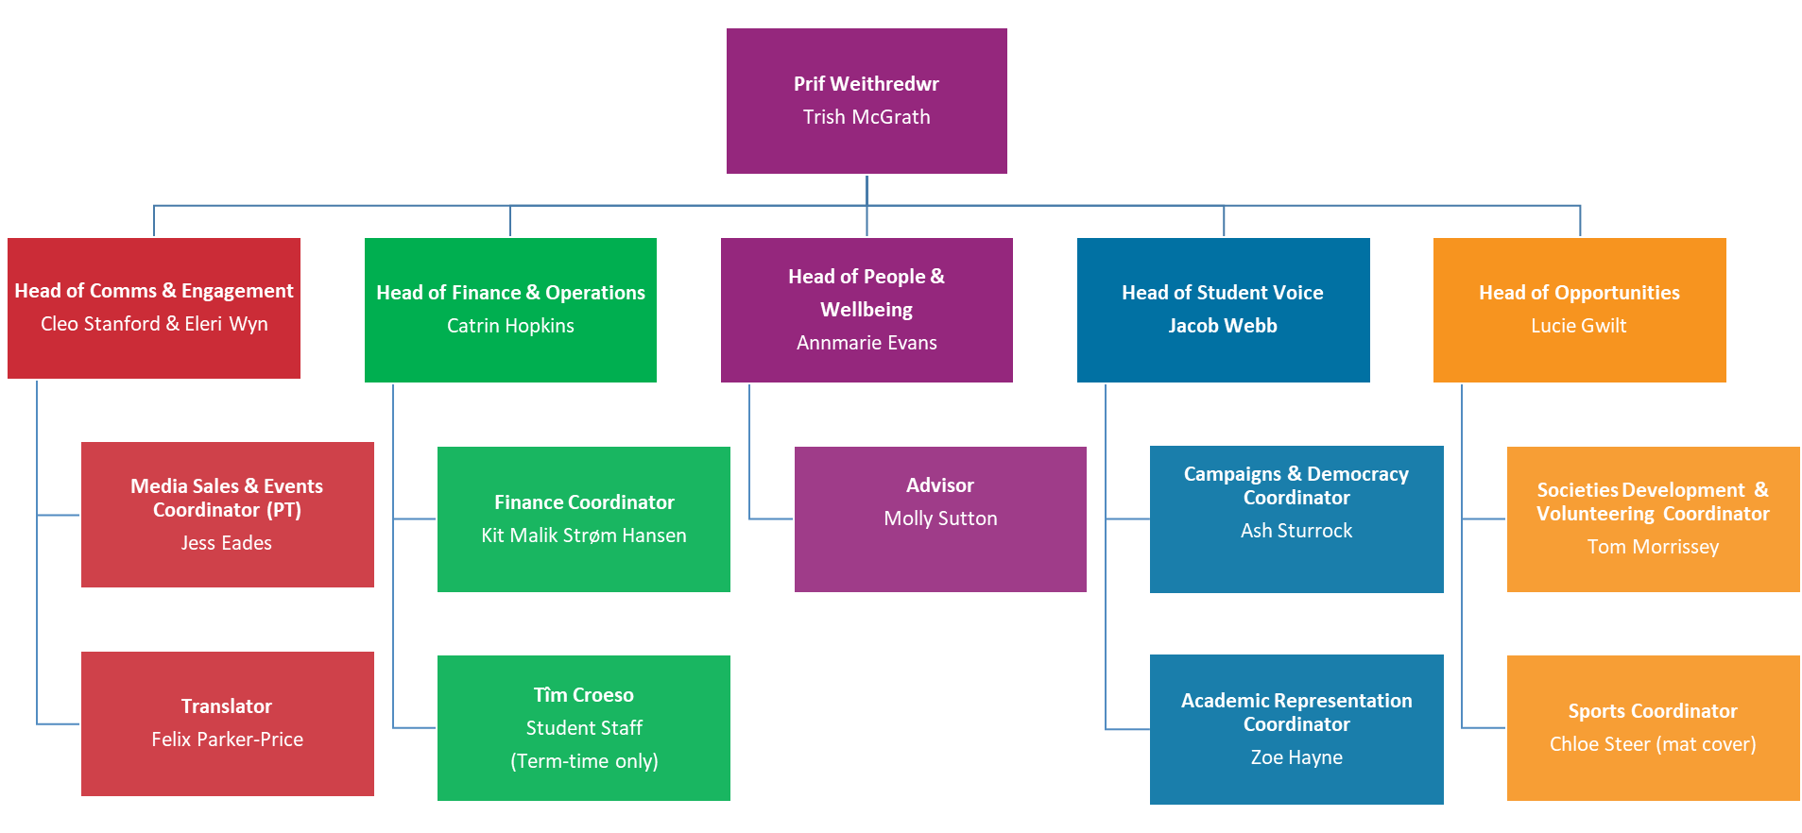
AberSU Organisation
Politically led by:
5 Society Reps
5 Sport Reps
2 UMCA Exec Reps
5 Full Time Officers
17 Volunteer Officers
Union Senedd
Supported by 14 permanent staff:
Governed by a board of Trustees: 5 x FT Officers, 1 PG student, 1UG student, 5 externals

Slide 8
MEET THE TEAM: STAFF
Prif Weithredwr
Trish McGrath
Head of Comms & Engagement
Cleo Stanford & Eleri Wyn
Head of Finance & Operations
Catrin Hopkins
Head of People &
Wellbeing
Annmarie Evans
Head of Student Voice
Jacob Webb
Head of Opportunities
Lucie Gwilt
Campaigns & Democracy Coordinator
Ash Sturrock
Academic Representation Coordinator
Zoe Hayne
Societies Development & Volunteering Coordinator
Tom Morrissey
Sports Coordinator
Chloe Steer (mat cover) Paige Cradduck mat leave
Media Sales & Events Coordinator (PT)
Jess Eades
Translator
Felix Parker-Price
Finance Coordinator
Kit Malik Strøm Hansen
Tîm Croeso
Student Staff
(Term-time only)
Advisor
Molly Sutton

Slide 9
Who’s who?:
Student Support & Representation
Jacob Webb
Head of Student Voice
Management, delivery and development of AberSU’s high quality democracy and rep provision
Zoe Hayne
Academic Rep Coordinator
Support and enable academic student representation
Ash Sturrock
Campaigns & Democracy Coordinator Empowers students and student representatives to have a strong voice that shapes the SU and beyond

Slide 10
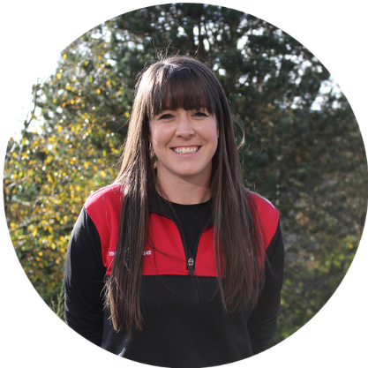
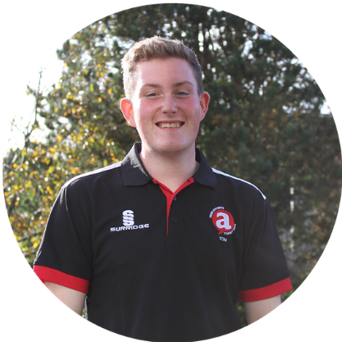
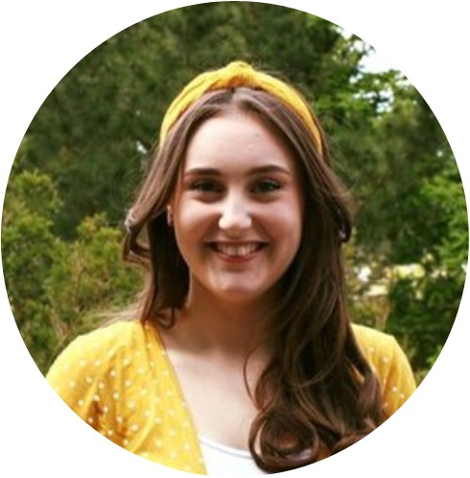
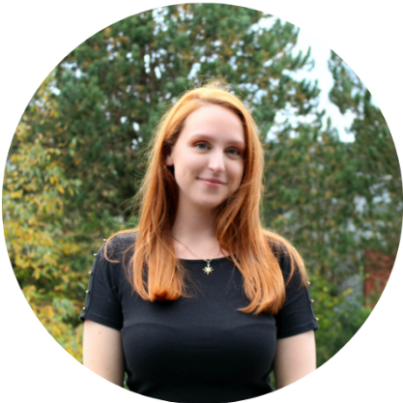
Who’s who?:
Student Opportunities
Lucie Gwilt
Head of Student Opportunities
Support, enable and empower students to develop and access a rich and diverse range of extra-curricular opportunities
Tom Morrissey
Societies Coordinator (plus volunteering
Promote student participation in societies for the purposes of growing shared interest communities
Chloe Steer (maternity cover)
Sports Coordinator
Promote student participation in sporting activities, including local, regional and national competition

Slide 11
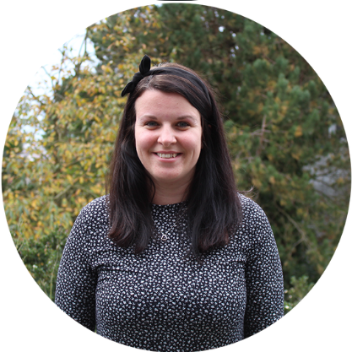
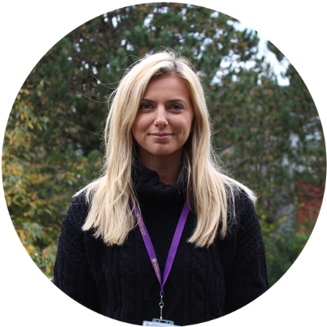
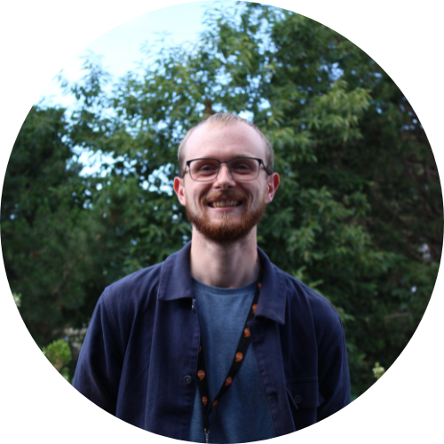
Who’s who?:
Communications & Engagement
Eleri Wyn & Cleo Stanford (job share)
Communications & Engagement Manager
Oversees the management, delivery and development of AberSU’s Communications and engagement activity
Jess Eades
Media Sales & Events Coordinator
Co-ordinates and drives sales revenue directly through the sale of media and sponsorship opportunities
Cleo is also responsible for creating engaging content that works to enhance the relationship between students and the Union.
Felix Parker-Price
To translate a variety of documents from English into Welsh and vice versa.

Slide 12
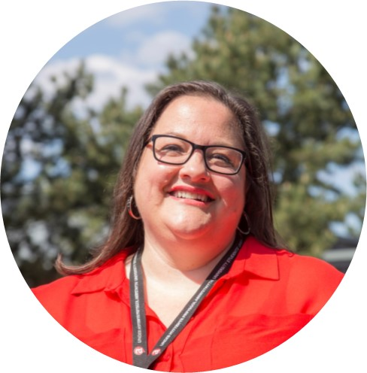
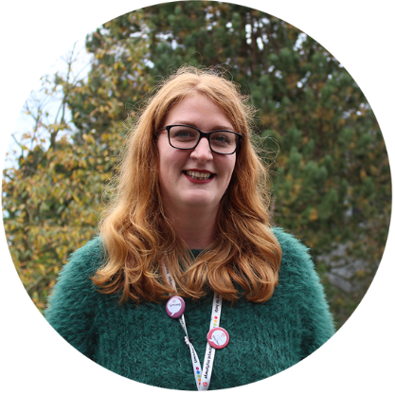
Who’s who?:
People and Wellbeing
Annmarie Evans
Head of People and Wellbeing
Supports staff wellbeing. Ensures AberSU’s staff related activity is in line with policy & procedures and within best practice
Molly Sutton
Student Advisor
Provides high quality, independent information, advice and advocacy, primarily for members in University disputes

Slide 13
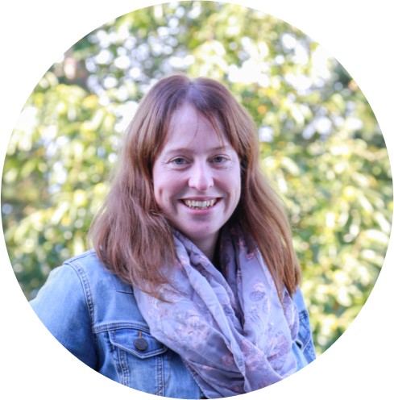
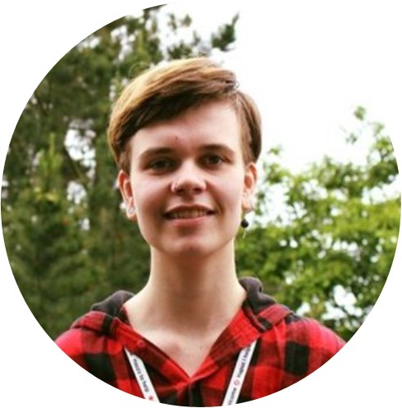
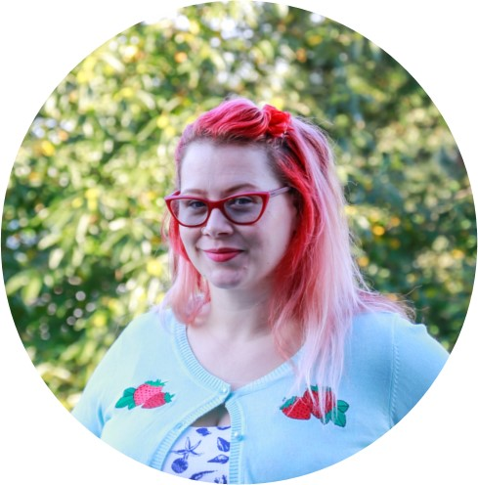
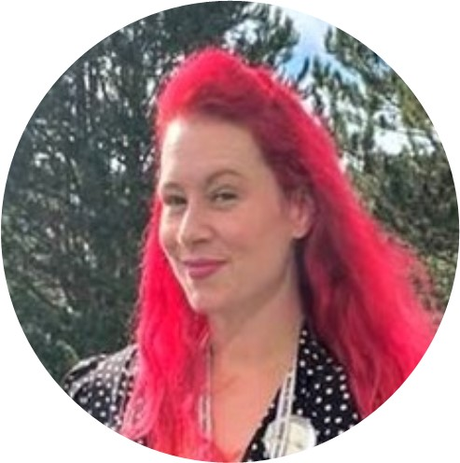
Who’s who?:
Finance and Operations
Catrin Hopkins
Head of Finance and Operations
Oversees the management, delivery and development of AberSU’s finance activity and resources
Kit Malik Strøm Hansen
Reception & Finance Coordinator
A welcoming and friendly first point of contact for students, staff and visitors entering or contacting the Students’ Union.
Administrates and supports SU finance.
Trish McGrath
Chief Executive Officer
Overall operational management of AberSU – responsible for the delivery of the Union’s purpose, vision and strategy and FT Officer support & development

Slide 14
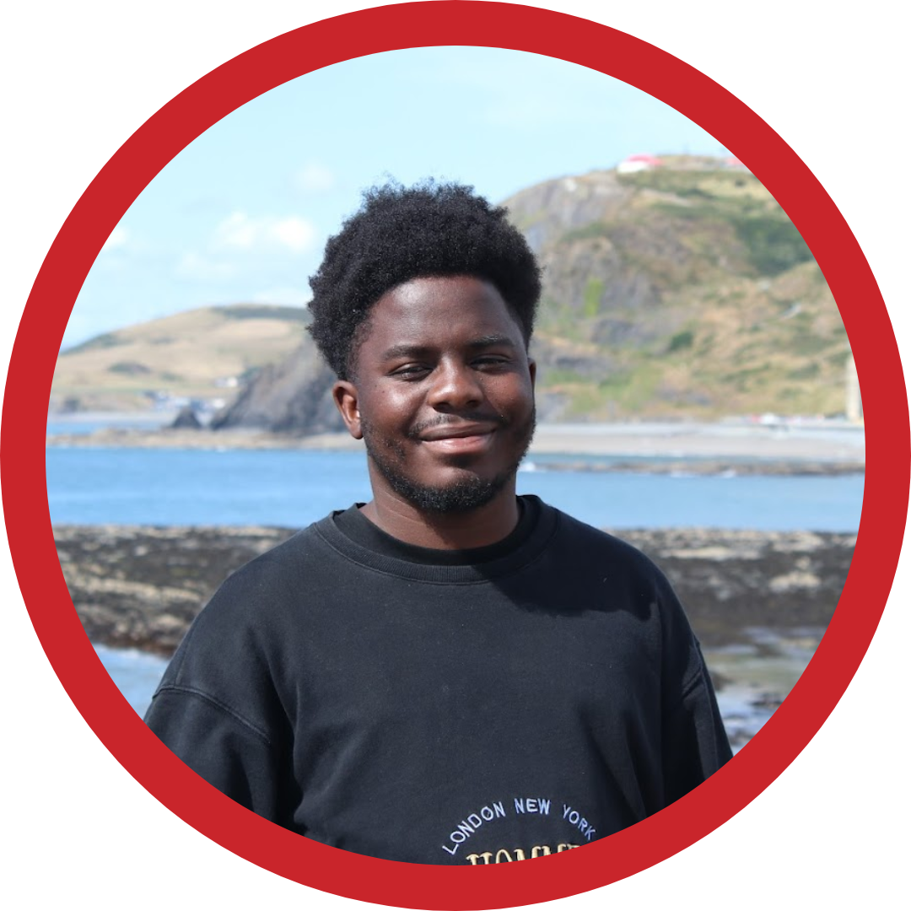
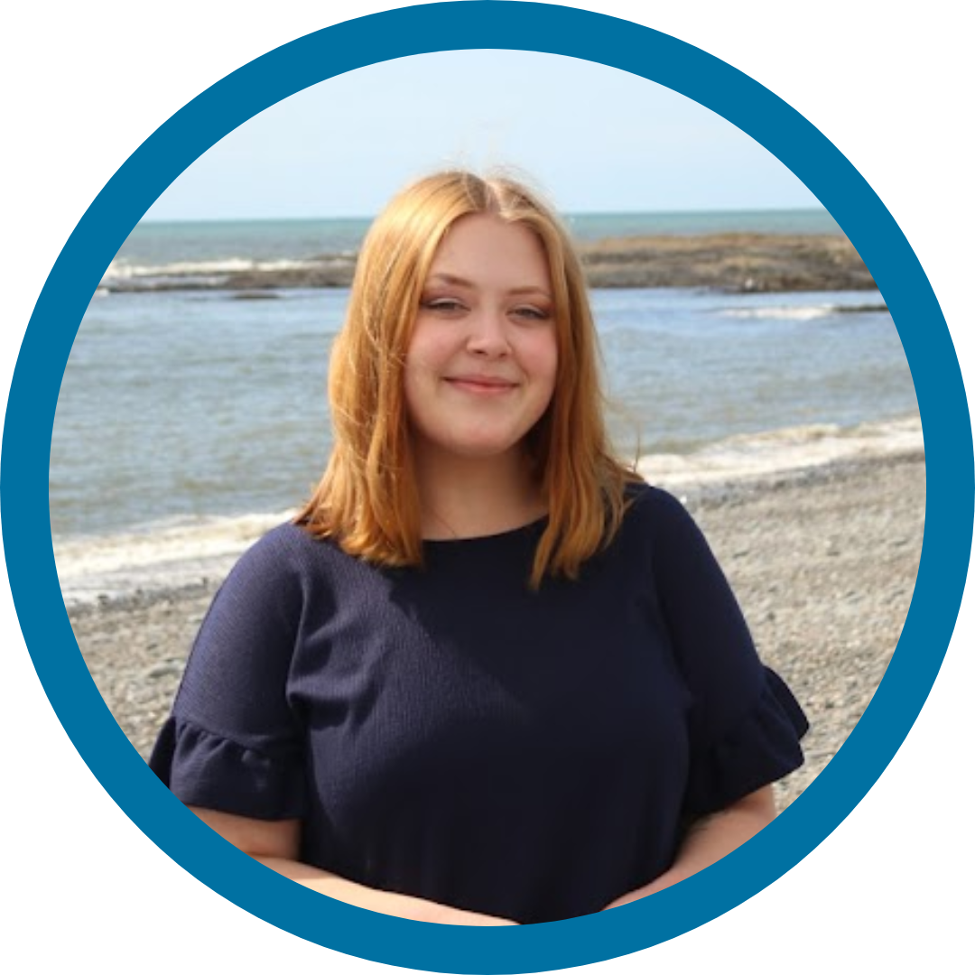
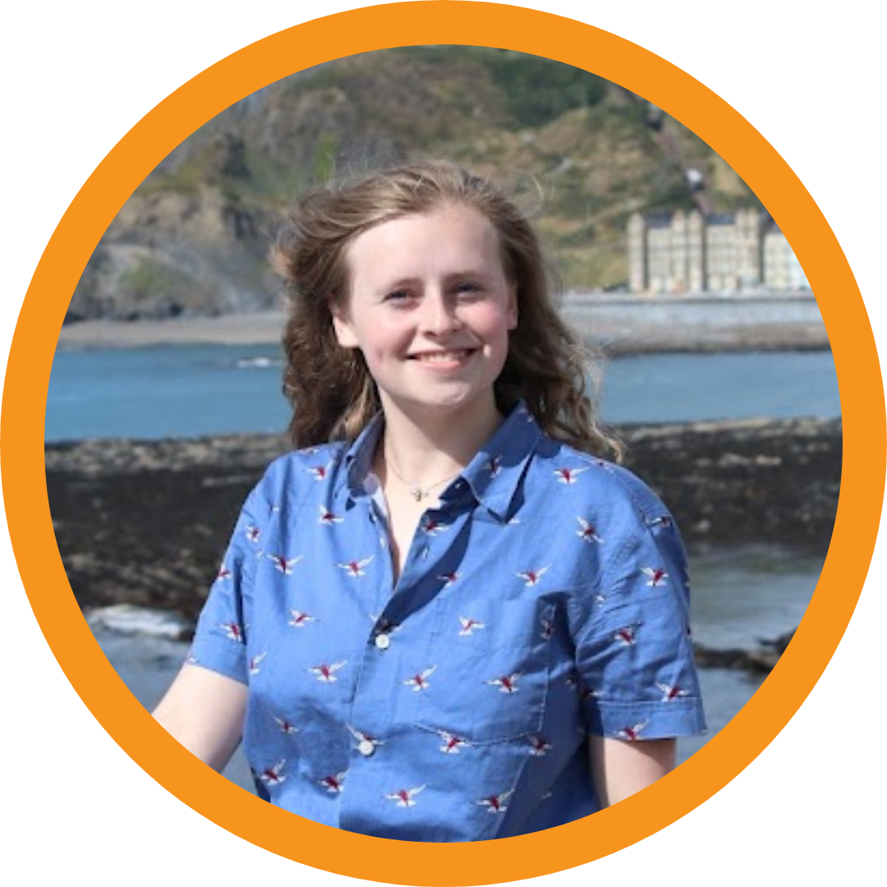
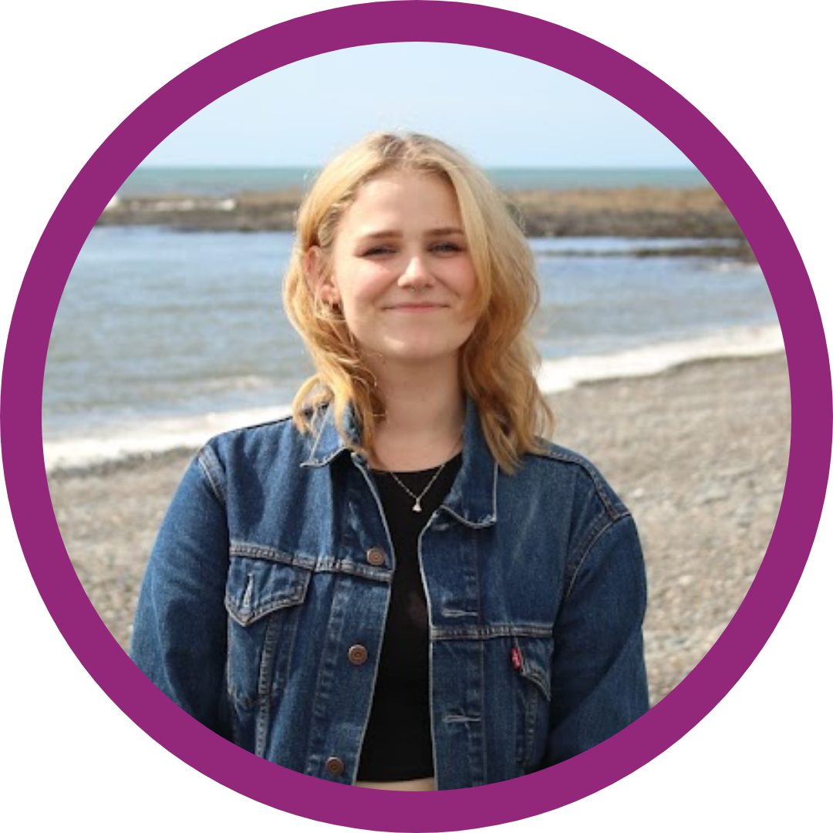
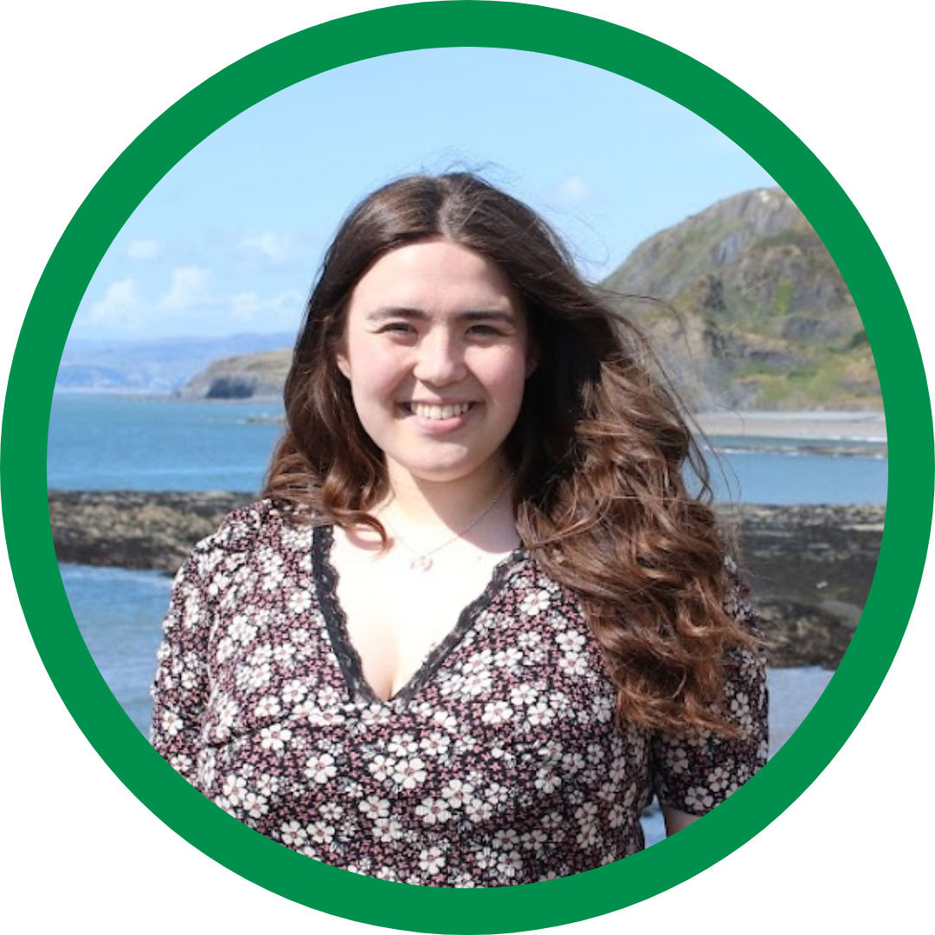
MEET THE TEAM: FULL-TIME OFFICERS
Full time Officers are elected in an all-student online vote and hold their positon for 12 months starting July each year
President: Bayanda Vundamina
Lead student voice for SU democracy, governance, external relations and primary spokesperson
Academic Affairs Officer: Anna Simpkins
Lead student voice for education policy, course representatives, academic campaigns
Student Opportunities Officer: Tiff McWilliams
Lead student voice for sports, societies, volunteering, skills development
Wellbeing Officer: Helen Cooper
Lead student voice for wellbeing, including mental health, finance, housing campaigns etc.
Welsh Culture Officer & UMCA President: Elain Gwynedd
Lead student voice for Welsh language & culture in the SU, Welsh language education, UMCA and Welsh community activity

Slide 15
MEET THE TEAM: VOLUNTEER OFFICERS
Full time Officers are elected in an all-student online vote and hold their positon for 12 months starting July each year
LGBTQ+ Officer
BAME Officer
Women’s Officer
Disabled Students Officer
Independent Students Officer
Environment & Sustainability Officer
Postgraduate Students Officer
Welsh Language Officer
Union Chairperson
International Students Officer
Mature Students Officer
Faculty Officers
UG Student Trustee
PG Student Trustee

Slide 16
STRATEGY

Slide 17
STRATEGY: MONITORING PROGRESS
The Students’ Union plans and monitors progress against our strategy in a number of key documents including an annual operating plan and a KPI (Key performance indicator) dashboard that is accessible to all staff.
KPIS include:
% of UG and PG students will have engaged with the SU (61% in 22-23)
Students feel like part of a community (68%)
Maintain or increase in club and society memberships
Maintain or improve SU and Uni NSS Score
Improvement on students self reporting as healthy
Improvement on students self reporting as happy
Accessed Advice (case or info)

Slide 18
DECISION MAKING
The Students’ Union is governed by overall policies/bye-laws outlined in our Constitution.
As a registered Charity the Students’ Union is governed and strategically led by the Board of Trustees. They are ultimately responsible for making sure that we operate in line with our charitable objectives. AberSU Trustee Board is made up of 12 members and meets at least four times a year
The Board is made up of:
5 Full Time Officer Trustees
2 Student Trustees
5 External Trustees
However, there are a number of protections in place to support Trustees to consider overall and high level impact and activity to protect student ability to define the political goals (policies) as members. The constitution outlines in detail how each aspect of decision making works but in brief Political decisions are made by students who can also set the direction for any aspect of the SU but all decisions and actions must be agreed by our Trustee Board.
Students largely make decisions by submitting ideas to our Senedd which are then voted on by our elected Senedd members

Slide 19
DECISION MAKING
c7500 students
Forums:
FT Officer accountability, general discussion and idea shaping groups
Senedd (SU policy making body):
All students can submit ideas, attend and debate.Only the roles listed below can vote:
5 Full Time Officers, 9 Volunteer Officers, 6 Faculty Reps, 2 UMCA Exec, 5 Sports Clubs Reps, 5 Societies Rep
Advisory Boards:
Feed into Union projects and Campaigns
FT Officers:
Academic Affairs
Student Opportunities
President
Wellbeing
Welsh Culture
Board of Trustees:
5 Full Time Officers, 1 elected UG, 1 elected PG, 5 Externals
Staff

Slide 20
POLITICAL POLICIES
Policy sets out what AberSU believes and works on; submitted as an idea it is then discussed by the Union’s Senedd or Big Meeting where it can either be passed or sent forward to be voted on by all Aberystwyth students in an All-Student Vote.
Passed policy will remain active for up to three years unless it is completed, amended or renewed.
A full list of current Policies can be found online: abersu.co.uk/shapeaber/policy/

Slide 21
POLITICAL POLICIES
Current policy:
The SU should endorse and back the UCU within their current strike action
Improve Welsh Language Provision in Modules
Assignment Grace Period and Penalties
Got Proof?
Introduce a No Confidence Vote for Academic Representatives and Sports and Society Committee Members
Should AberSU reduce the number of Faculty Officers?
Boat Shed to Boathouse
Bring Back RAG Charity/ies
Ensure RAG Funds the Wellbeing Pot to Support Aber Students
Sports Hall Improvements
Strength and Conditioning for Sports
We as Students' Want Aberystwyth University cannot green wash anymore. If we are saying we are plastic free, we should be plastic free

Slide 22
POLITICAL POLICIES
Current policy:
Aberystwyth University to Divest in Fossil Fuels
Should the SU & University commit to becoming more Sustainable?
The SU should ban the use of single use plastic for events such as Freshers (including external organisations) and general day-to-day use.
The University and AberSU should suspend their banking with fossil fuel investment banks and switch to a more ethical, green bank instead
To Reduce the Use of Buying from Amazon Within the Students Union
Redeveloped Sports Facilities
AberSU should continue to support trans and gender diverse students by providing gender affirming products.
Healthcare for our Trans students
Stopping Spiking and Supporting Survivors
University and SU to take a stand in supporting Pro-Reproductive Rights Universally.
We should host an annual SHAG Week

Slide 23
AVERAGE YEAR
The SU operates strategically in academic years rather than calendar years. In general there are a number of key elements of the average academic year to be aware
July
New FT Officers start there role and have intro training
Graduation
Planning and prep
August
Planning and prep
September
Majority of students arrive for the start of Semester one
Freshers week and Freshers Fair
October
First set of democratic meetings
Rep and vacant role elections
Homecoming event
November
Aber Challenge
Second set of democratic meetings
December
End of Semester 1
January
Exams
Planning and prep
Refreshers
February
Superteams
Third set of democratic meetings
March
Main SU elections (FT roles)
Fourth set of democratic meetings
April:
Varsity & Socs Fest
May
Aber 7s
Awards (or in April depending on Easter)
Exams
June
Planning and prep
* Plans are subject to change

Slide 24
KEY COMMUNICATIONS & EVENTS
The SU uses a few key communications platforms:
Website: abersu.co.uk
Instagram: umabersu
Facebook: umabersu
Tiktok: @umabersu
Events:
We share all our events, club and societies events and try to include other relevant local events on our website:
https://www.abersu.co.uk/ents/
If our website or channels can share useful info for you don’t hesitate to get in touch with sumarketing

Slide 25
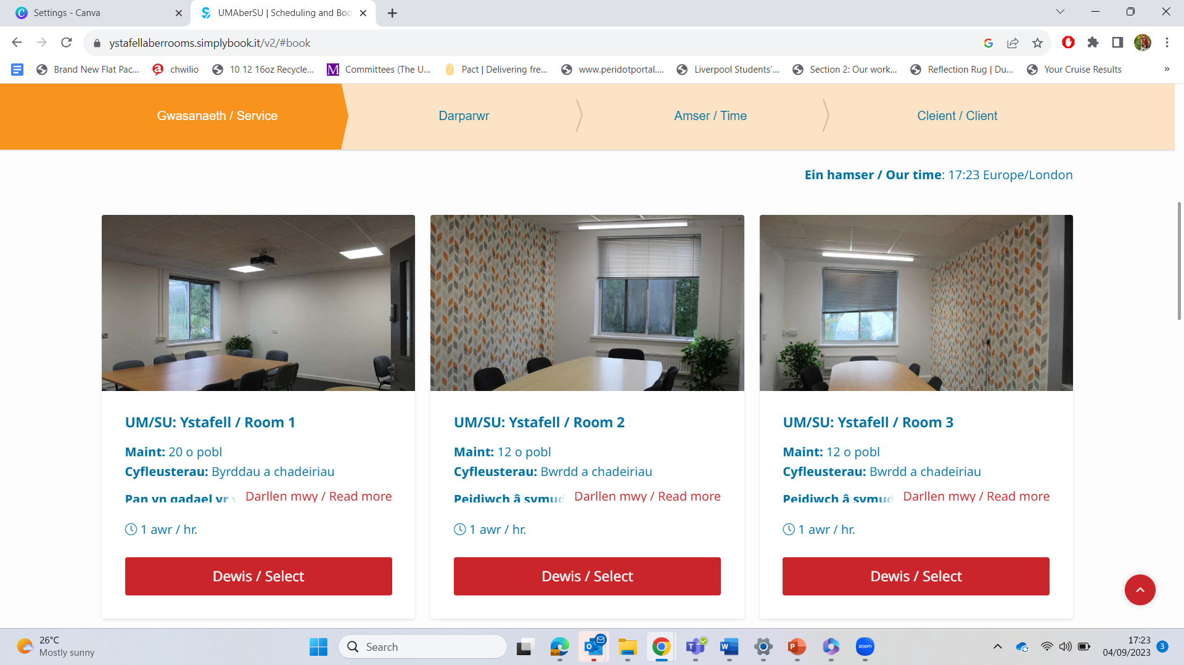
BOOKING ROOMS AND VENUES
We have lots of spaces available for students to book – Res life are welcome to use them too. Give the SU an email at union@aber.ac.uk if you want to look at multiple options or book the Main room. You can also see availability and book online here: https://www.abersu.co.uk/aboutaber/roombookings/

Slide 26
BENCHMARKS AND AWARDS
The Students’ Union has taken part in a number of benchmark/development schemes and we’re proud to have been successful in gaining a number of awards.
Benchmarks
2023: SOS Green Impact Excellent Award
2020: Chwarae Teg Fairplay Employer Scheme – Leading level awarded
2019: NUS Quality Students’ Unions
Charters:
We are a Mindful Employer, sign up to the HALO hair code, are a Tourette’s friendly employer and pay the Real Living Wage.
Awards
2023: NUS recognition for our cost of living, sexual health campaign and student engagement events
2022: NUS Wales Staff Member aand Campaign of the year
2020: Chwarae Teg Diversity Champion Award winner
2019: Aberystwyth University St David’s Day Award – Promoting Welsh in the Workplace

Slide 27
ANY QUESTIONS?
?
?
?

