Slide 1
Undeb Aberystwyth
Priorities 25-26
Millie, Nanw, Espe, Ffion, Tanaka and Trish

Slide 2





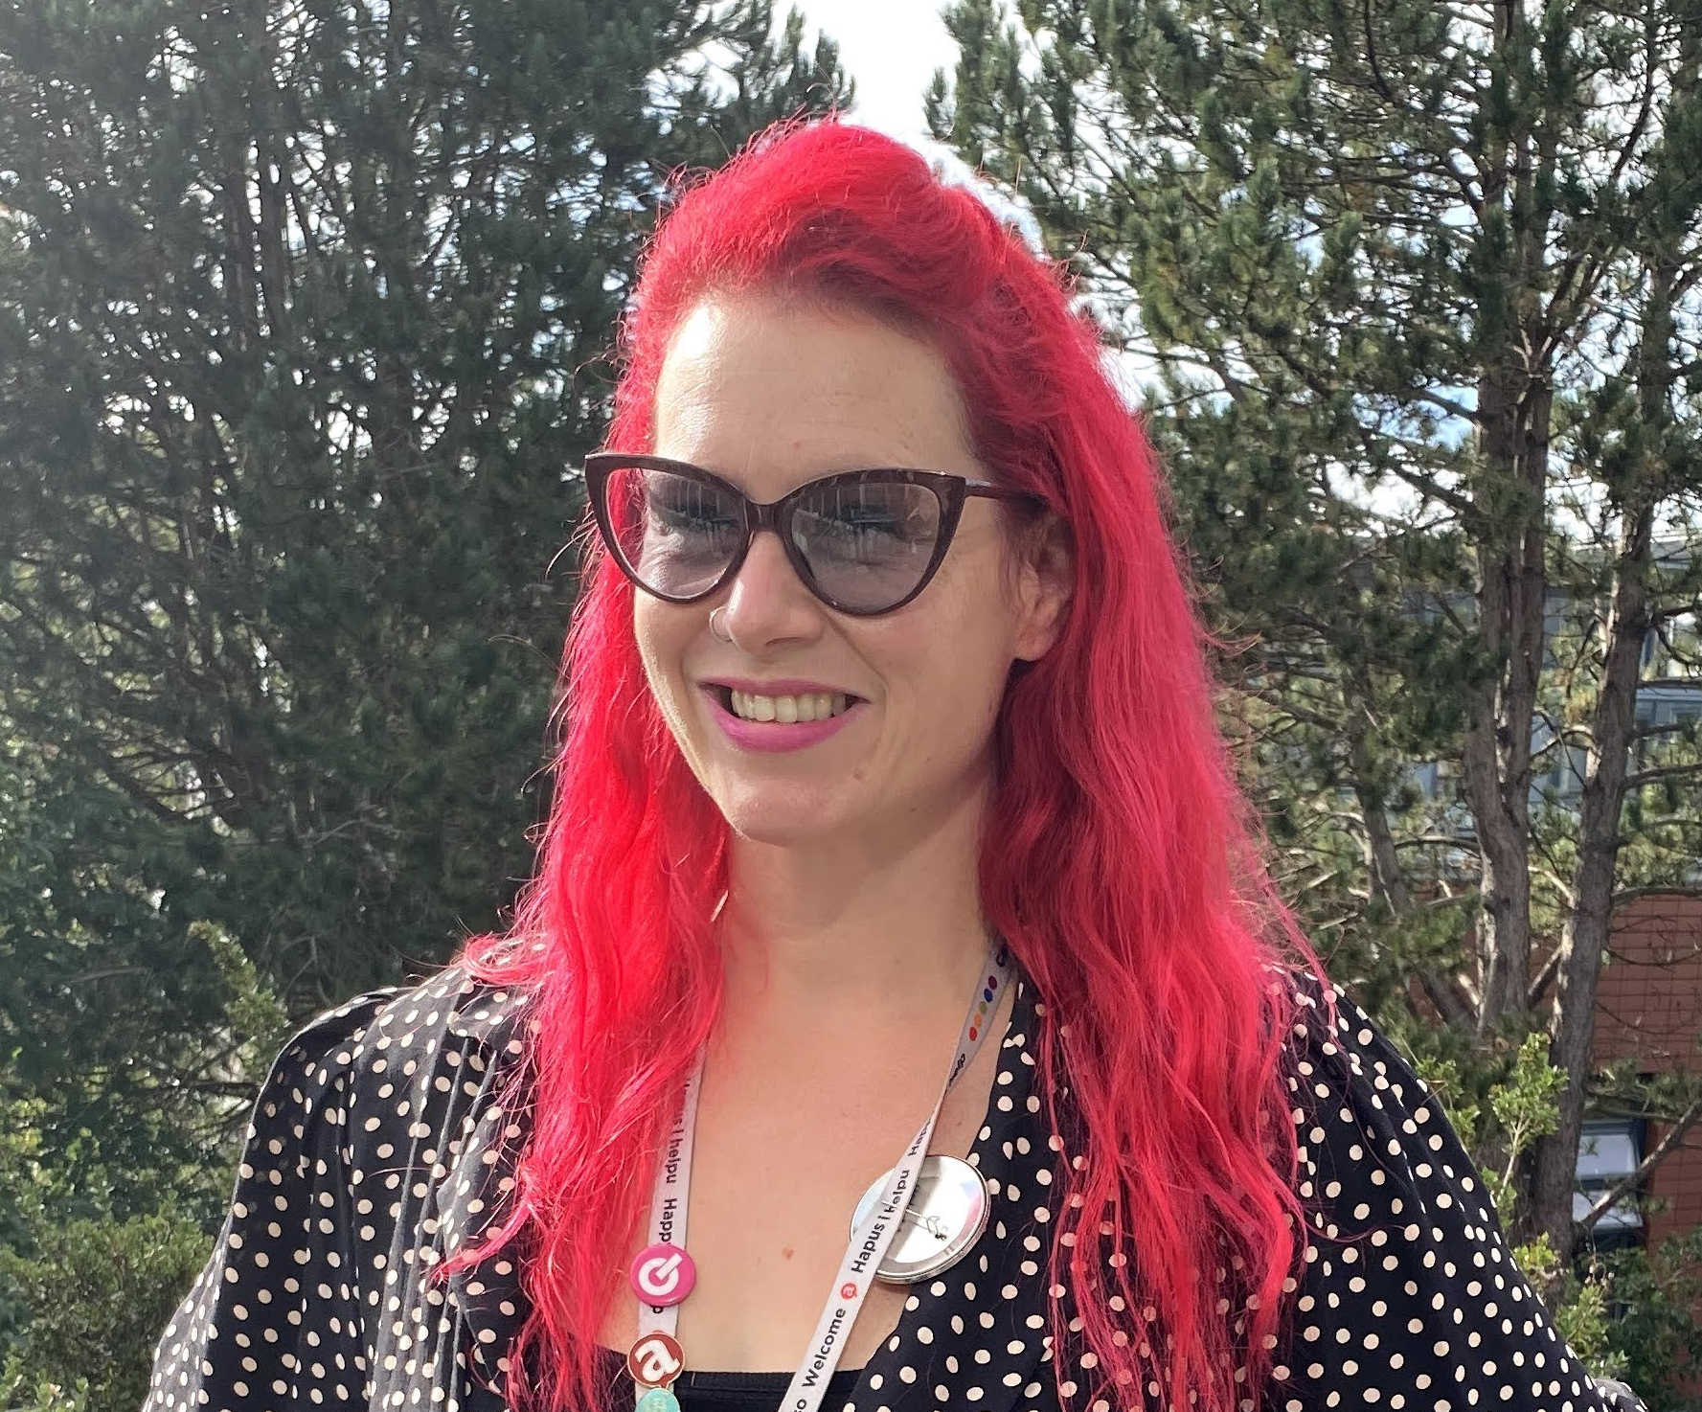
Introductions
President: Millie
Student voice for: External press and SU representation, democracy, governance, external relations
Academic Affairs Officer: Esperanza
Student voice for : education policy, course representatives, academic campaigns
Student Opportunities Officer: Ffion
Student voice for : sports, societies, volunteering, skills development
Wellbeing Officer: Tanaka
Student voice for : wellbeing, finance, housing campaigns
Welsh Culture Officer & UMCA President: Nanw
Student voice for : Welsh language & culture in the SU, UMCA and Welsh community activity, Welsh language education and provision
CEO: Trish
Overall strategic and general management of Undeb Aber

Slide 3
What we will cover:
Introductions – including SU people and purpose
Officer priorities
Strategic Priorities
Democratic priorities

Slide 4
Undeb introductions - People
Elected Student Leadership
(political direction)
5 Full time Officers (reducing to 4 from July 2026)
14 Volunteer Officers
Staff leadership and SU development
(operational)
Staff leadership team (6.2FTE)
Staff Coordinators (7.2 FTE)
SU Trustee Board
(oversight)
2 x PT student staff and 6 Professional pathways placement students
c200 Academic Reps
c700 Club and Society Committee member
5 Full time Officer Trustees (elected)
1 PG and 1 UG Student Trustees (elected)
5 External Trustees (appointed)

Slide 5
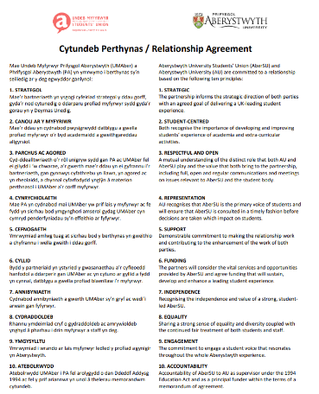
SU Governance and purpose
Established in 1900 and all registered students are members.
Students’ Unions are governed by several factors:
1: The University has duties under the Education Act which are usually
monitored by a Code of Practice that is regularly reviewed.
2: MEDR (formerly HEFCW) set out activities that they expect SU’s and
Universities to meet which are outlined in our Relationship Agreement.This
includes that “AU recognises that AberSU is the primary voice of students
and will ensure that AberSU is consulted in a timely fashion before decisions
are taken which impact on students”
3: Charity Commission Operational guidance for Students’ Union’s (Charities Act 2011)
4: Our Articles of Association and Constitution
5. Student democracy - Policy and student leadership
The University currently provides 81% of SU income - the rest is generated by media sales and other activity

Slide 6
SU Governance and purpose: Charity Commission
AUSU’s object is the advancement of education of Students at Aberystwyth University for the public benefit by:
3.1 promoting the interests and welfare of Students at Aberystwyth University during their course of study and representing, supporting and advising Students;
3.2 being the recognised representative channel between Students and Aberystwyth University or any other external bodies and
3.3 Providing social, cultural, sporting and recreational activities and forums for discussions and debate for the personal development of its Students.

Slide 7
SU Governance and purpose – MEDR Requirements
Ensure the democratic election of officers to deliver the mission of the SU in line with its constitution
Support, represent and advise students
Promote and protect the interests and welfare of students at the institution during their course of study, in partnership with the institution
Provide and support an effective system of student representation in order to achieve its object of being the recognised representative channel between students and the institution, and any other external bodies
Write and review the Student Charter jointly with the institution.
Produce an annual student statement, to form the basis of dialogue with the institution, report to students, and inform the development of the student submission for the institutional review.
Provide trained advisors to give independent advice on academic and welfare issues, which link effectively with the services of the institution, and is underpinned by an agreement between the SU and the institution.

Slide 8
SU Governance and purpose – MEDR Requirements
Promote student participation in surveys and other forms of feedback, including the National Student Survey, as appropriate.
Provide or support social, cultural, sporting and recreational activities and for a for discussions and debate for the personal development of its students
Ensure its advice and services, and access to these, meet the needs of the diverse student body
Identify an appropriate range of commercial activities and other streams of funding to support SU activities
In addition to the core functions, the partners may agree funding for additional activities or services, which may vary with local needs and circumstances. These additional activities or services must align with the powers of the SU, which are helpfully defined in the model constitution.
The SU, and the institution as funders, need to consider the core functions and any additional activities or services to be provided by the SU, and agree a mechanism for allocating appropriate funding.

Slide 9
Students’ Union Priorities
OFFICER PERSONAL PRIORITIES
Decided by Officers independent of strategy and policy
STRATEGIC PRIORITIES
Undeb Strategic plan and operating plans
DEMOCRATIC PRIORITIES & POLICY
Decided by students
Informed and influenced by
Insight and Research
Student ideas, Senedd and AGM
Advisory Groups and Committees
Best Practice and Trends

Slide 10
Students’ Union Priorities: Officer personal priorities
OFFICER PERSONAL PRIORITIES
Decided by Officers independent of strategy and policy
OFFICER PERSONAL PRIORITIES
Decided by Officers independent of strategy and policy
STRATEGIC PRIORITIES
Undeb Strategic plan and operating plans
DEMOCRATIC PRIORITIES & POLICY
Decided by students
Informed and influenced by
Insight and Research
Student ideas, Senedd and AGM
Advisory Groups and Committees
Best Practice and Trends

Slide 11
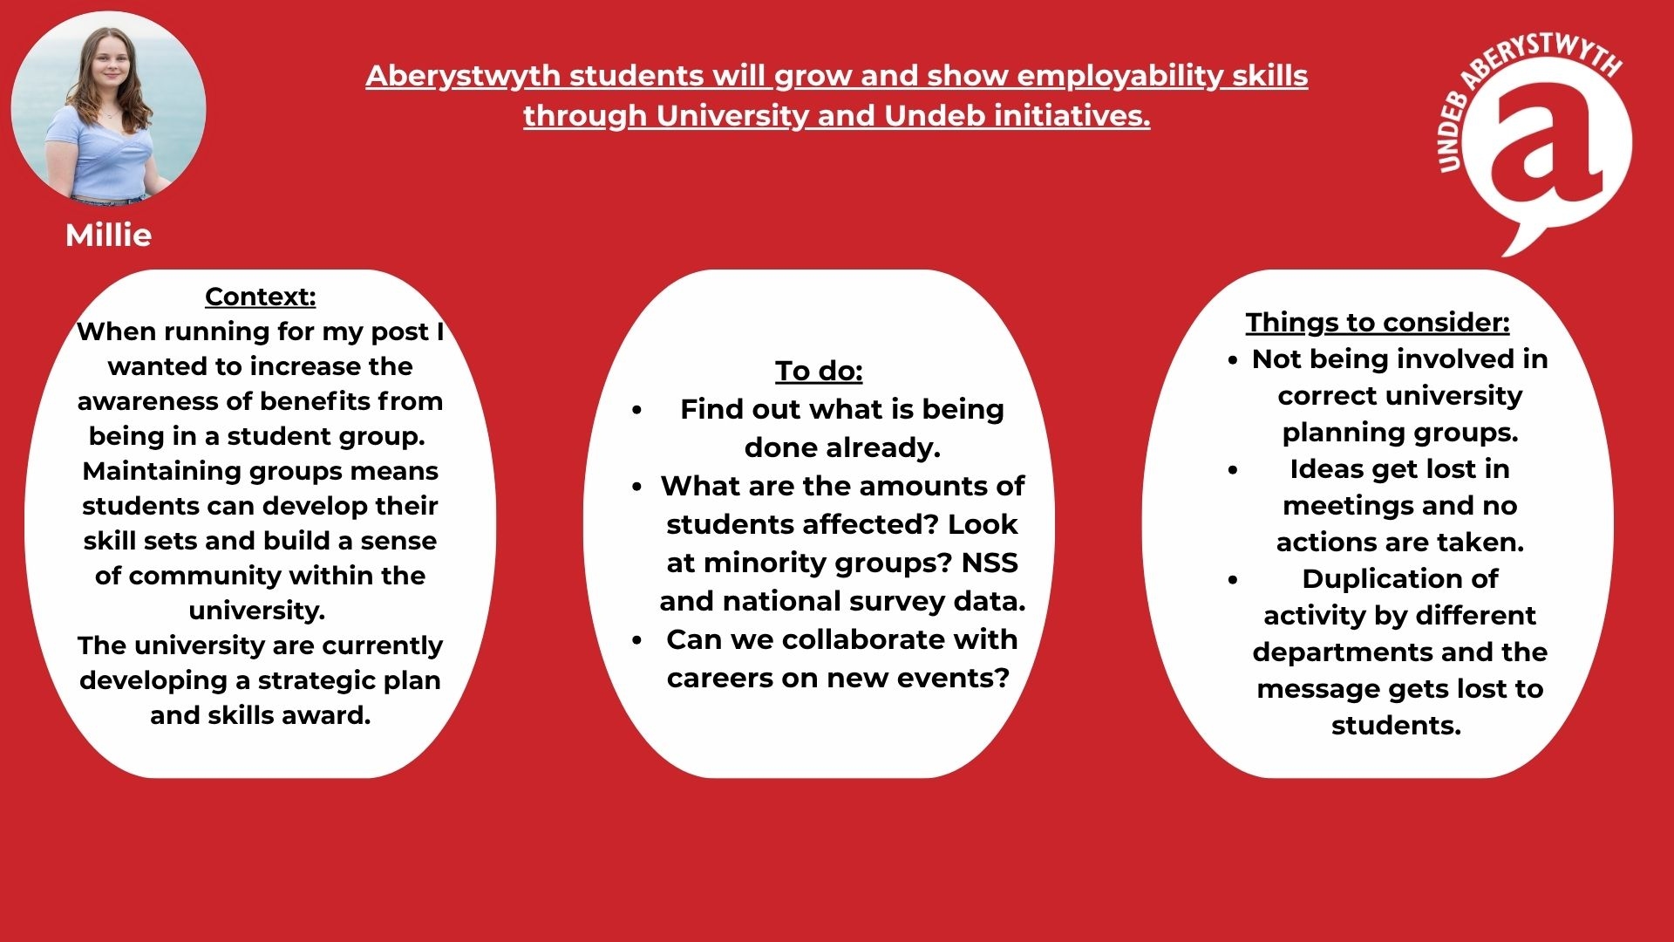

Slide 12
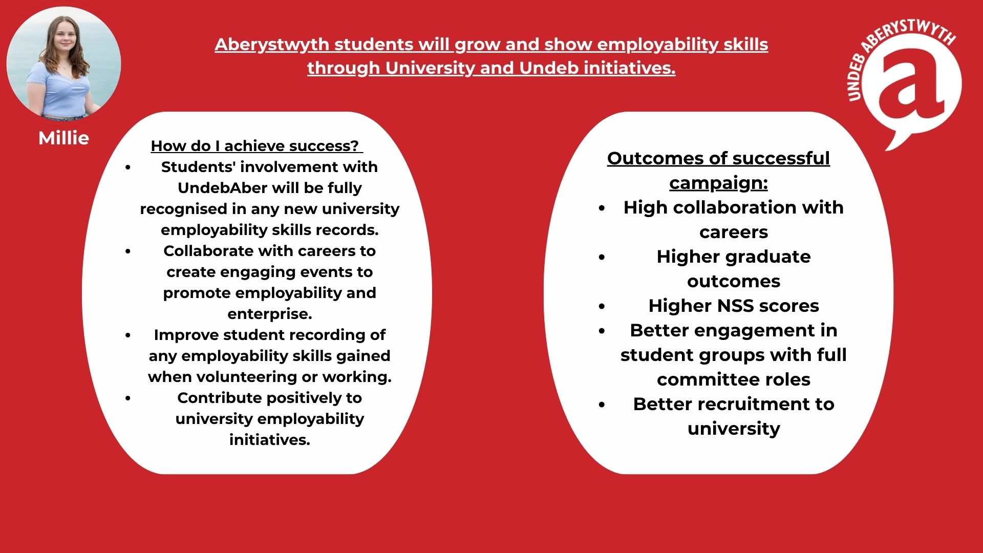
Officer personal Priorities:
Outline each one

Slide 13
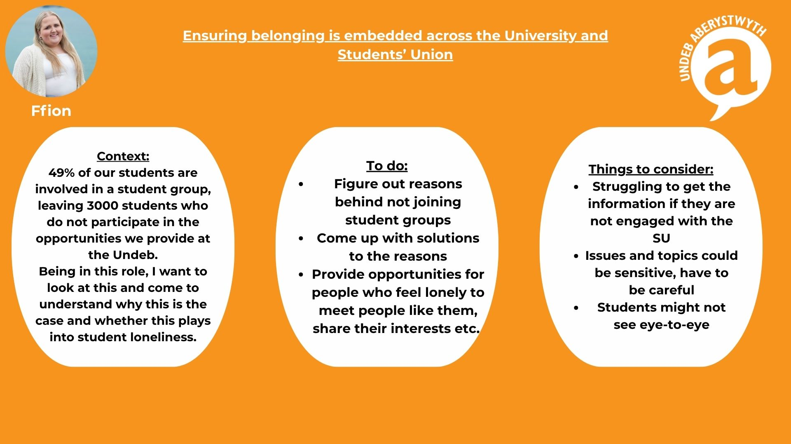
Officer personal Priorities:
Outline each one

Slide 14
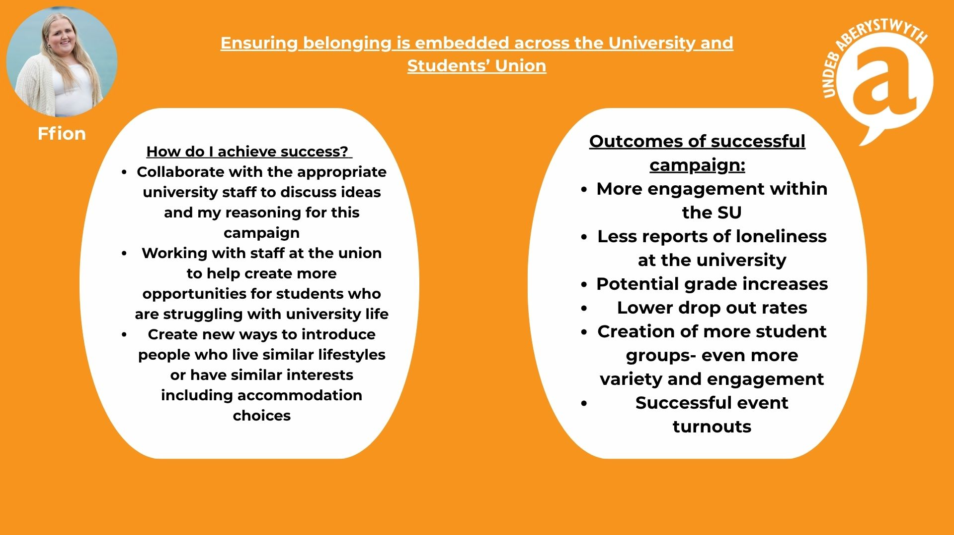
Officer personal Priorities:
Outline each one

Slide 15
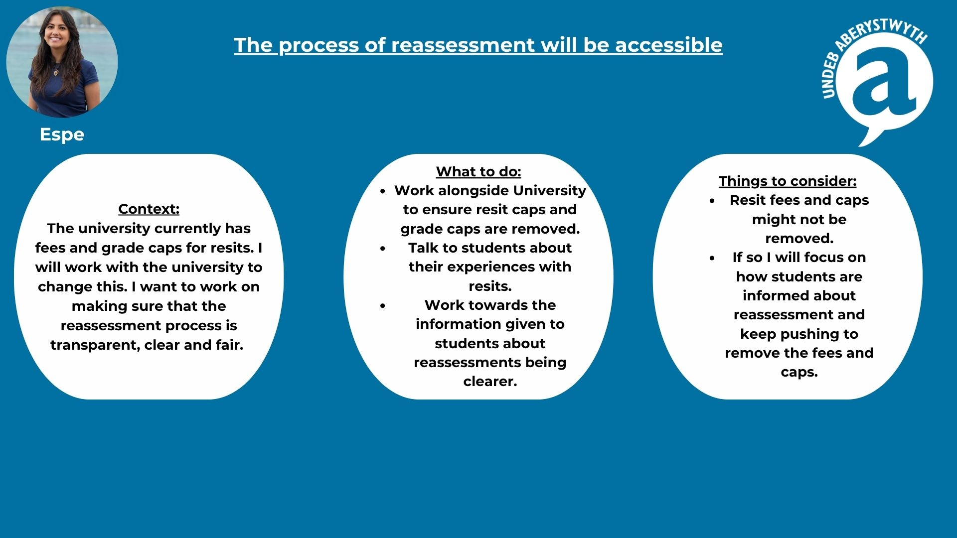
Officer personal Priorities:
Outline each one

Slide 16
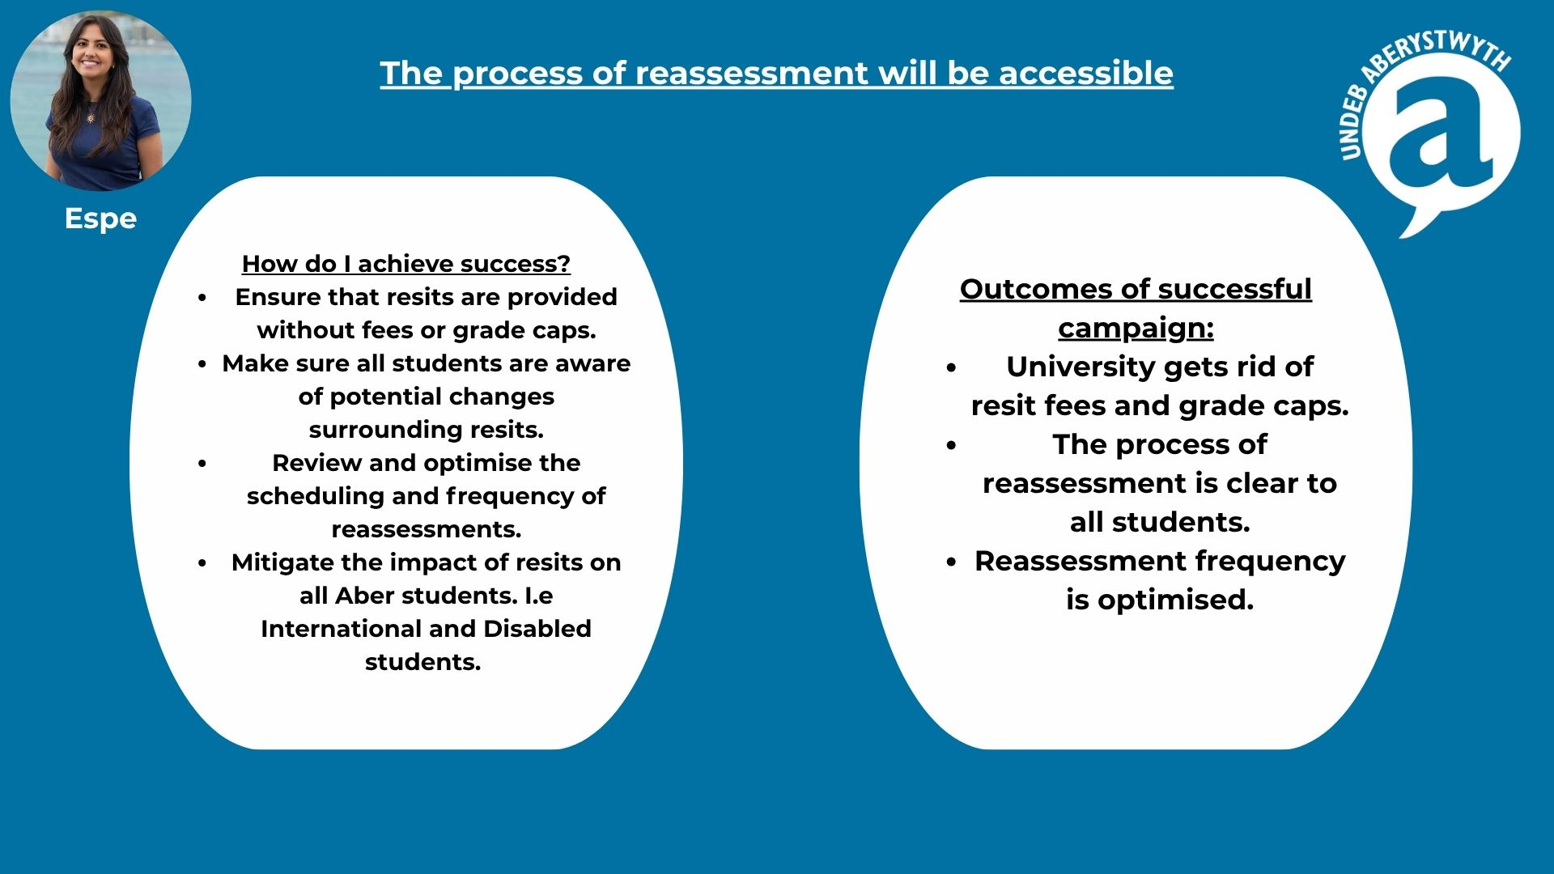
Officer personal Priorities:
Outline each one

Slide 17

Officer personal Priorities:
Outline each one

Slide 18
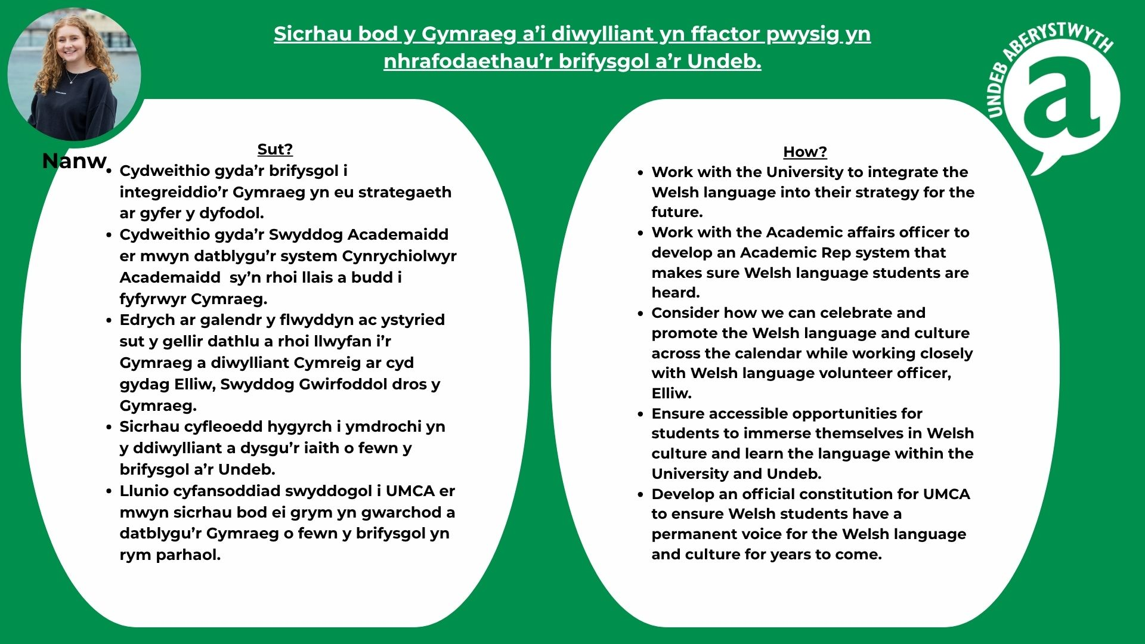
Officer personal Priorities:
Outline each one

Slide 19
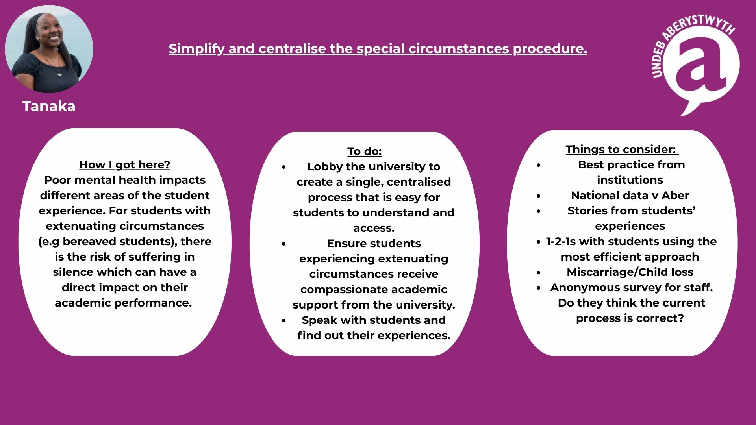
Officer personal Priorities:
Outline each one

Slide 20
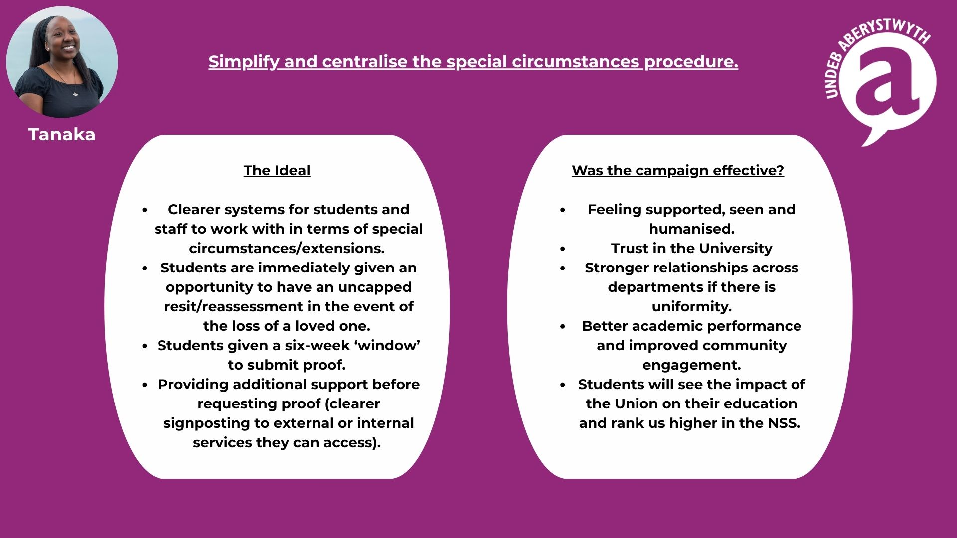
Officer personal Priorities:
Outline each one

Slide 21
Any Questions for the Officers?

Slide 22
Students’ Union Priorities: Strategy
STRATEGIC PRIORITIES
Undeb Strategic plan and operating plans
DEMOCRATIC PRIORITIES & POLICY
Decided by students
OFFICER PERSONAL PRIORITIES
Decided by Officers independent of strategy and policy
STRATEGIC PRIORITIES
Undeb Strategic plan and operating plans
Informed and influenced by
Insight and Research
Student ideas, Senedd and AGM
Advisory Groups and Committees
Best Practice and Trends

Slide 23
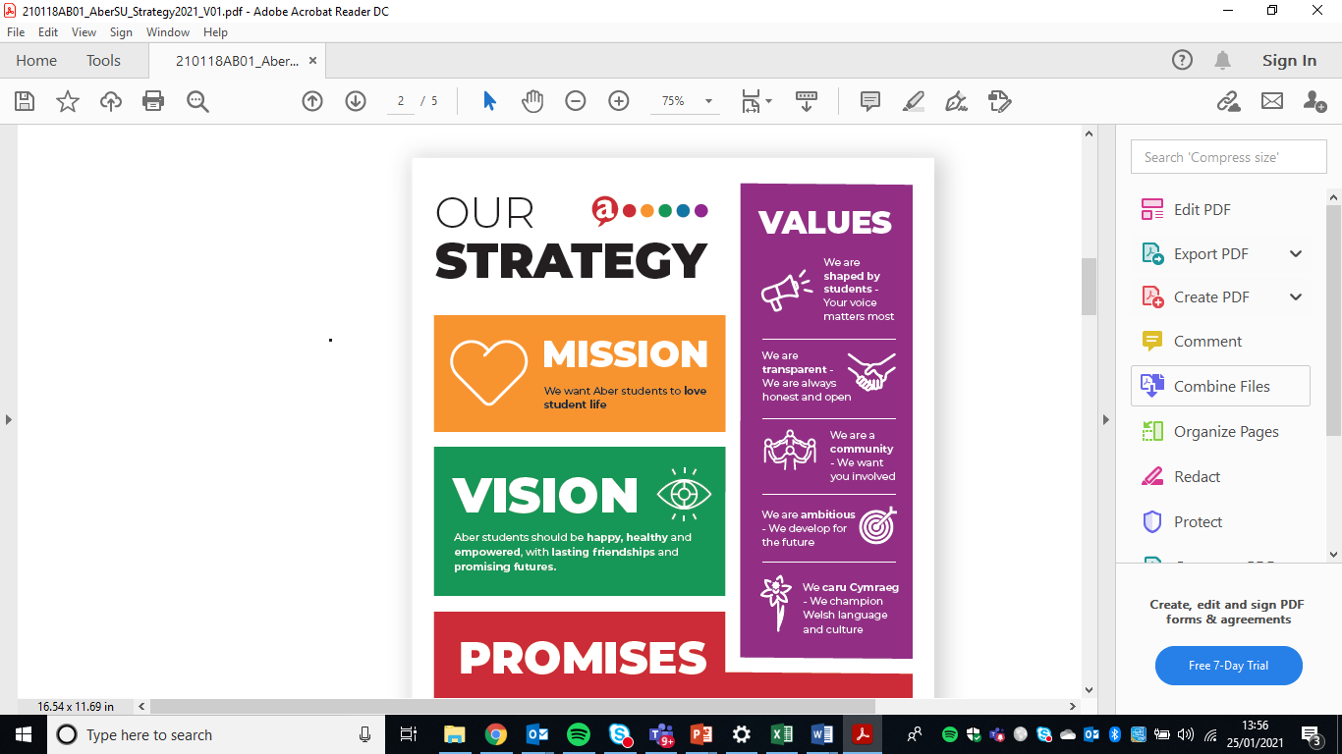
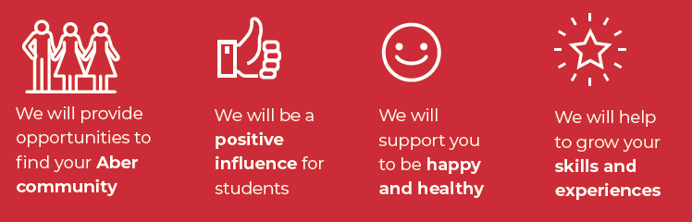
Undeb strategic Priorities:

Slide 24
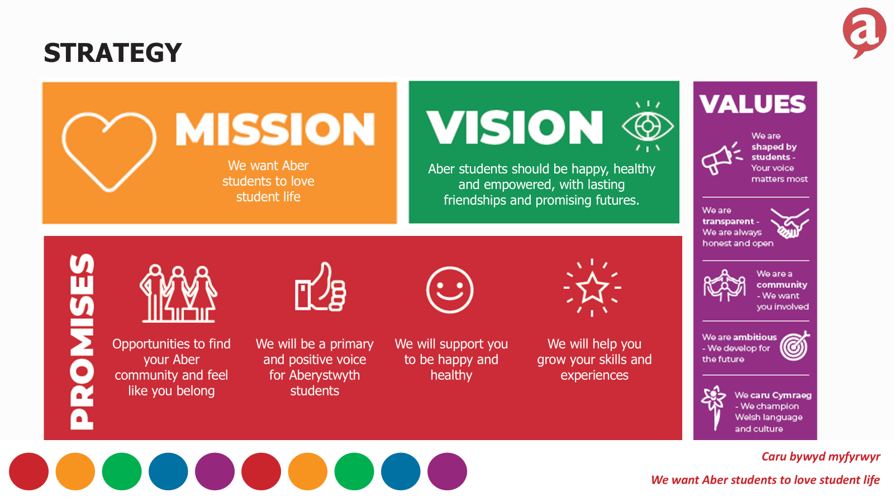
STRATEGY

Slide 25
SU activity - what staff think
We asked University staff to tick which activities or services that you think the Students' Union delivers:
Entertainments/events
Academic societies
Freshers entertainments/events
British University and Colleges Sport Clubs
Shop
Bar
Recreational Sports Clubs
Volunteering
Academic representation
Aber 7's Rugby
Finance advice
Graduation/Summer Ball
Housing advice
Mental health advice/support
External trips and tours
University process advice
Careers advice/support
Bus cards
Skills Development/training

Slide 26
SU activity - what staff think

Slide 27
SU activity - what staff think
*UMCA is part of the wider Undeb

Slide 28
WHAT DO WE DO?
Student Voice
Student Opportunities
Communications &
Engagement
Full-time Officer support & dev
Volunteer Officers
Campaigns
Consultation
Liberation, Equality and Inclusion
Elections
Decision making (policy)
Academic Representation
Inter University sport (BUCS).
Societies & social Sport Student Group development
Superteams, Aber7s, Varsity
Aber Challenge
Volunteering inc A-Team and action days
Minibuses
Website & Social media
Marketing income in Fairs
Brand guidelines
Physical signage and promotion
Public relations
Event support
Insight
Translation
People & Wellbeing
Advice Service | HR & support
Finance & Operations
Includes Reception, maintenance,
Charity governance, SU sector
work

Slide 29
STUDENT VOICE
Strategic priorities
We will be a primary and positive voice for Aberystwyth students
The student voice matters most. We will be the primary voice of Aber students and ensure that your views, needs and concerns shape the Students’ Union and the University, and are heard locally and nationally.
Students will understand what the SU is, that they are members and will shape Undeb Aber activity and Policy
Students will lead and shape their education and wider University experience
We will support you to be happy and healthy
Championing the rights of students and fighting injustice.
Staff FTE: 2.7
Student Voice
Full-time Officer support & dev
Volunteer Officers
Campaigns
Consultation
Liberation, Equality and Inclusion
Elections
Decision making (policy)
Academic Representation
Key measures and impacts – in 2024-25
SU and Uni NSS Score – SU:73% and University 86%
38% turnout in our March elections (highest in the UK) - 31% in officer elections
33 Officer Elections candidates
72% Academic Reps trained completion and 97% reps that felt their Induction training helped them better understand their role
13 policy ideas submitted and quorate AGM for 4 years

Slide 30
STUDENT OPPORTUNITIES
Strategic priorities
We will provide opportunities to find your Aber community and feel like you belong.
We offer the chance to try something new, enjoy hobbies, socialise and belong in lasting and meaningful friendships and Communities.
Students will connect volunteering, clubs and societies membership or leadership, and Academic Rep experiences with the Students’ Union.
Champion and support student groups to create events, activities, media and campaigns increasing numbers of opportunities to contribute, lead and learn
We will help students find, grow and celebrate their diverse communities
Students will play a positive and active role in contributing to the wider Aberystwyth Community
Staff FTE: 3
Student Opportunities
Inter University sport (BUCS).
Societies & social Sport Student Group development
Superteams, Aber7s, Varsity
Aber Challenge
Volunteering inc A-Team, action days
Minibuses
Key measures and impacts - In 2024-25:
49% of students in Team Aber
80% of students reported feeling part of a community
5,671 club and society memberships
48% of Club and Society members and 50% of Presidents, Treasurers and Secretaries defined as other or woman

Slide 31
STUDENT OPPORTUNITIES
Strategic priorities
We will help you grow your skills and experiences
We want our students to feel proud of their achievements and to share a vibrant set of skills and experiences that support them to take the next steps after study.
Provide fulfilling and relevant student Volunteering Opportunities and experiences.
Our full range of student volunteers including committee members, volunteer Officers and academic reps, will recognise their achievements and identify and evidence the transferrable skills that they have gained.
Students will be prepared for life after University, whether that is further study or starting whatever career, or life path they choose
Staff FTE: 3
Student Opportunities
Inter University sport (BUCS).
Societies & social Sport Student Group development
Superteams, Aber7s, Varsity
Aber Challenge
Volunteering inc A-Team, action days
Minibuses
Key measures and impacts - In 2024-25:
Employability: 85% of student reps and committee members feel their skills and experiences have grown while in post
Retention: In the last three years students involved in clubs and societies withdrew less than none-involved peers. In 2024, 6% of students involved in a club or society withdrew from university, compared to 10% of those who were not involved.
Hours and Skills: 320 volunteers logged 15,000 hours and 1065 skills
Aberystwyth volunteers shortlisted for BUCS and WCA Volunteer of the year award
96% of core committees completed training

Slide 32
COMMUNICATIONS & ENGAGEMENT
Strategic priorities
We will be a primary and positive voice for Aberystwyth students
We will be the experts on Aber students – we will know how they behave, what they value and what they want/need
Enabler: Communications and identity
Communications strategy
Build an interactive online community
To build a recognisable Undeb Aberystwyth brand
Undeb Aber will be a go to trusted source for relevant, current information for Aber students
Undeb Aber will shout about successes, share wins and good news throughout the year
Staff FTE: 3.3
Communications &
Engagement
Website & Social media
Marketing income in Fairs
Brand guidelines
Physical signage and promotion
Public relations
Event support
Insight
Translation
Key measures and impacts:
1 million website views
Average SU email open rate of 31%
Facebook reach – 109,440 and Instagram reach – 115,946
Participation numbers in surveys and research
£37,600 earned in marketing and advertising income
Use of translation service to generate income

Slide 33
PEOPLE & WELLBEING
Strategic priorities
We will support you to be happy and healthy
Life has its ups and downs and we want to help you ride the waves and weather the storm.
The Advice Service will be the go-to source for independent and confidential advice and will empower students to make informed choices.
Championing the rights of students and fighting injustice.
To ensure that University support and wellbeing work is fit for purpose and considers the individual needs of the students.
Organisation sustainability
A positive staff culture where staff and officers seek to improve and develop - learning from best practice in the sector
Staff FTE: 2.2
People & Wellbeing
Advice Service
HR & staff wellbeing
Key measures and impacts – in 2024-25:
320 students were supported in 374 cases by the Advice Service
Our advice guides were viewed 7000 times
We co-developed and achieved SOS Reducing Drug and Alcohol Impact Award with the University
100% of our 13.4 staff and 5 officers would recommend the SU as a good place to work in our Employee engagement survey

Slide 34
Finance & Operations
Strategic priorities
Organisation sustainability
Spaces fit for purpose
A strong and active Trustee Board
Reliable financial information will enable action and the SU will operate in budget
A positive staff culture where staff and officers seek to improve and develop - learning from best practice in the sector
We will work to help tackle the Climate Crisis, by making our operations more sustainable and leading environmental campaigns
Partnerships & relationships
Ensure effective SU representation at all levels
Build community connections and partnerships
Build productive commercial relationships that support our success
Build and maintain positive relationships with key University staff and students
Staff FTE: 2.2
Finance & Operations
Charity governance, finance, facilities, reception, maintenance,
Key measures and impacts:
62% of students engaged with the SU
Demographic analysis compared to population
Performance against budget including club and Society spending
Space use – last year our spaces were booked 4980 times
Annual accounts and charity return on time

Slide 35
AVERAGE YEAR
The SU operates strategically in academic years rather than calendar years. In general there are a number of key elements of the average academic year to be aware
July
New FT Officers start their role and have intro training
Graduation
Planning and prep
August
Planning and prep
September
Majority of students arrive for the start of Semester one
Freshers week and Freshers Fair
October
Senedd and Advisory Boards
Rep and vacant role elections
Homecoming event
November
Y Ddawns Ryng-gol
Aber Challenge
December
End of Semester 1
January
Exams
Planning and prep
Refreshers
February
Superteams
Senedd and Advisory Boards
March
Main SU elections (FT roles)
Fourth set of democratic meetings
Eisteddfod Ryng-gol
AGM
April:
Varsity & Socs Fest
May
Aber 7s
Awards (or in April depending on Easter)
Exams
June
Planning and prep
* Plans are subject to change

Slide 36
BENCHMARKS AND AWARDS
The Undeb has taken part in benchmarking/development schemes and we’re proud of our success, including:
Benchmarks
2025: SOS Drug and Alcohol Impact Award
2024: SOS Excellence in Green Impact
2023: SOS Excellence in Green Impact
2023: NUS Employee Engagement All Stars (for employee satisfaction)
2023: Excellent in SOS Green Impact
2020: Chwarae Teg Fairplay Employer Scheme – Leading level awarded
2019: NUS Quality Students’ Unions - Very good and Excellent outcomes
Awards
2025:Shortlisted for Mental Health & Wellbeing Wales Award – Wellbeing in the Workplace
2023: What Uni Student Choice Awards Winner for Student Life
2023: NUS recognition for our cost of living, sexual health campaign and student engagement events
2022: NUS Wales Awards: Campaign of the Year
2022: NUS Wales Awards: Staff member of the Year
2020: Chwarae Teg Diversity Champion Award winner

Slide 37
Students’ Union Priorities: Democratic policy
DEMOCRATIC PRIORITIES & POLICY
Decided by students
OFFICER PERSONAL PRIORITIES
Decided by Officers independent of strategy and policy
STRATEGIC PRIORITIES
Undeb Strategic plan and operating plans
DEMOCRATIC PRIORITIES & POLICY
Decided by students
Informed and influenced by
Insight and Research
Student ideas, Senedd and AGM
Advisory Groups and Committees
Best Practice and Trends

Slide 38
Students’ Union Democratic Priorities
Student ideas
-Start a new activity
-Stop or change a current activity
-Adopt or change a stance
-Update or change current Policy
Quick fix
-No major political/ financial implications.
-Requests to change the way we present information, or to make more information available
-A simple request to make a small change to the building e.g. signage
-Feedback to consider or include in Officer meeting contributions
Change made
Activity started
Senedd or AGM
Ideas are discussed and voted on.
Senedd = elected students vote
AGM = all students vote
(All student vote = online vote by all students)
Change or stance made
Activity started
Assigned to a FT Officer
as a priority

Slide 39
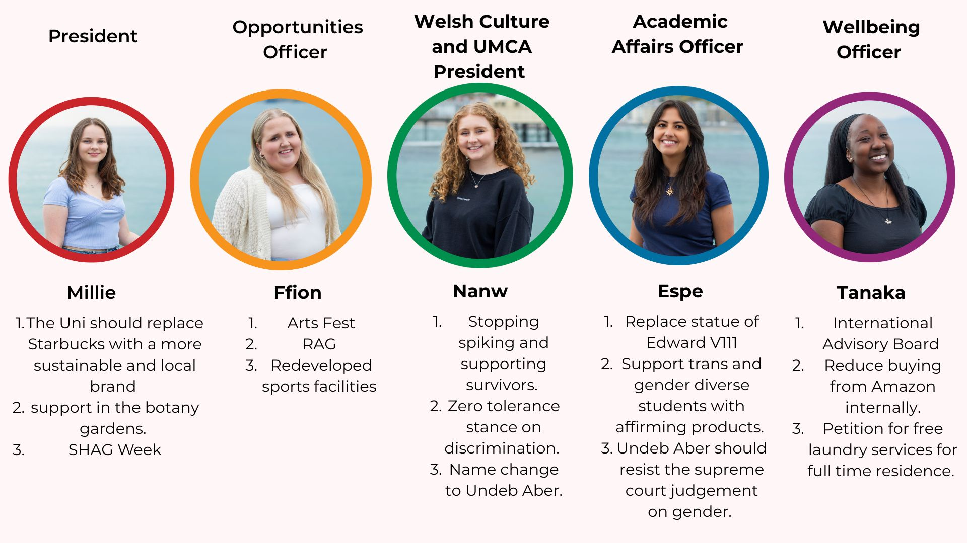
Students’ Union Democratic Priorities

Slide 40
Diolch for the chance to present and for listening
Any questions?
?
?
?

