Slide 1


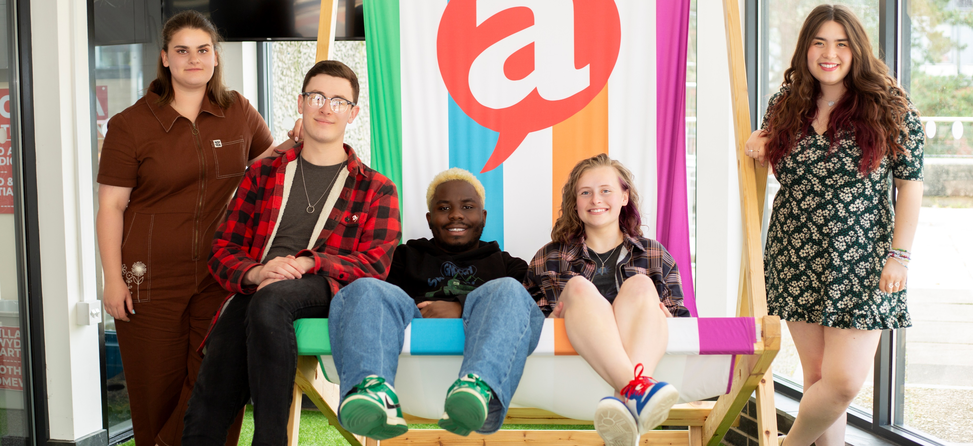
Croeso i Aberystwyth!
Welcome to Aberystwyth!

Slide 2








Bayanda Vundamina
Elain Gwynedd
Helen Cooper
Tiff McWilliams
William Parker
Academic Affairs Officer
The student voice for all things academic - The role focuses on promoting our students’ academic interests.

Slide 3


Slide 4
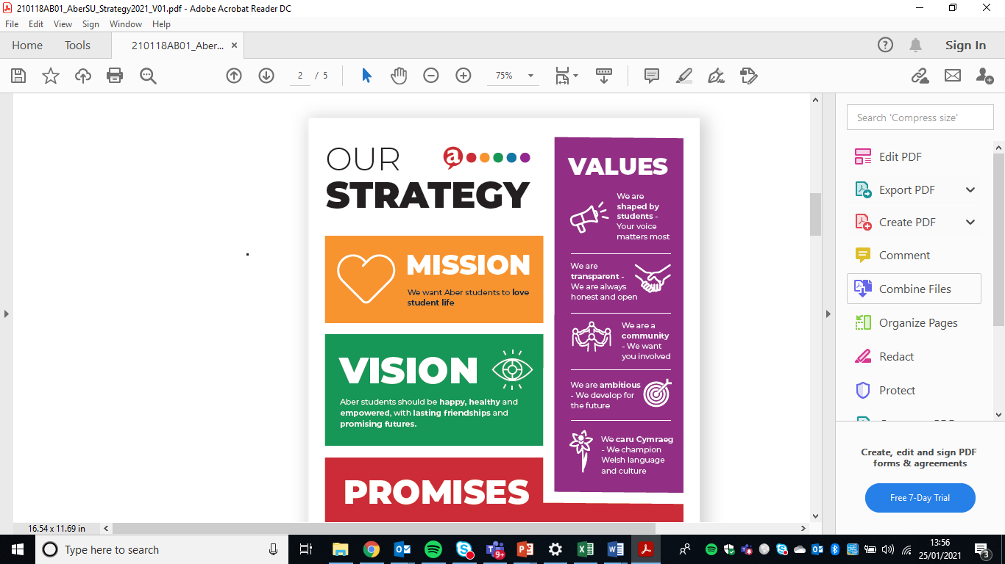
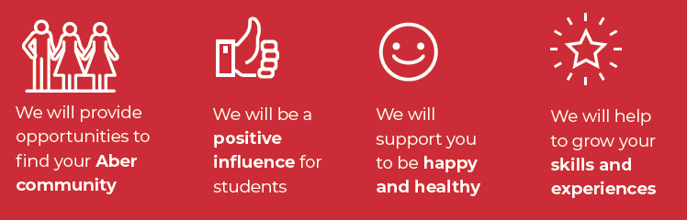
YOU ARE A MEMBER OF ABER SU
(a registered charity working for Aber Students)
16/17

Slide 5



PROMISE 1:
We will provide opportunities to find your Aber community
44 SPORTS CLUBS
& 70 SOCIETIES
www.abersu.co.uk/teamaber

Slide 6




PROMISE 1:
We will provide opportunities to find your Aber community
41%
KEY EVENTS
of students are a member of TÎMABER

Slide 7

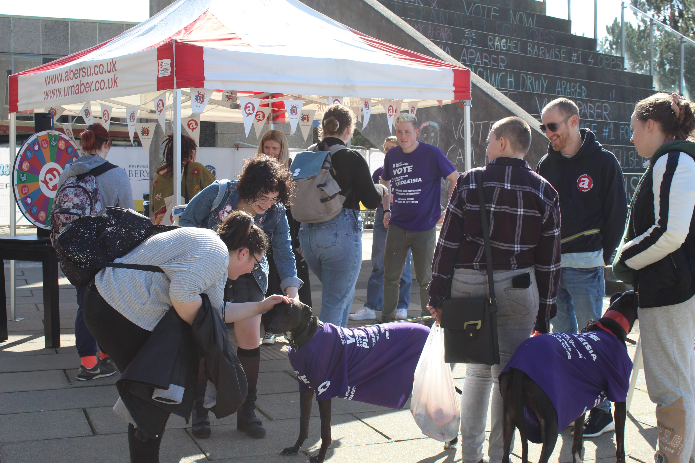
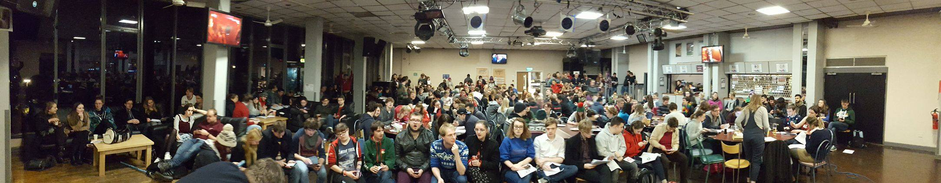
PROMISE 2:
We will be a positive influence for students
How?
Standing and voting in elections
Sharing ideas
Taking part in research and surveys
Talk to Student Reps and Officers
Come along to a SU Senedd or General Meeting
Be an Academic rep
We support 250 reps, we are a student voice on every university committee & speak locally and nationally about your interests.
2,290 students
26%
of Aber students
voted in our main AberSU Elections in March!

Slide 8





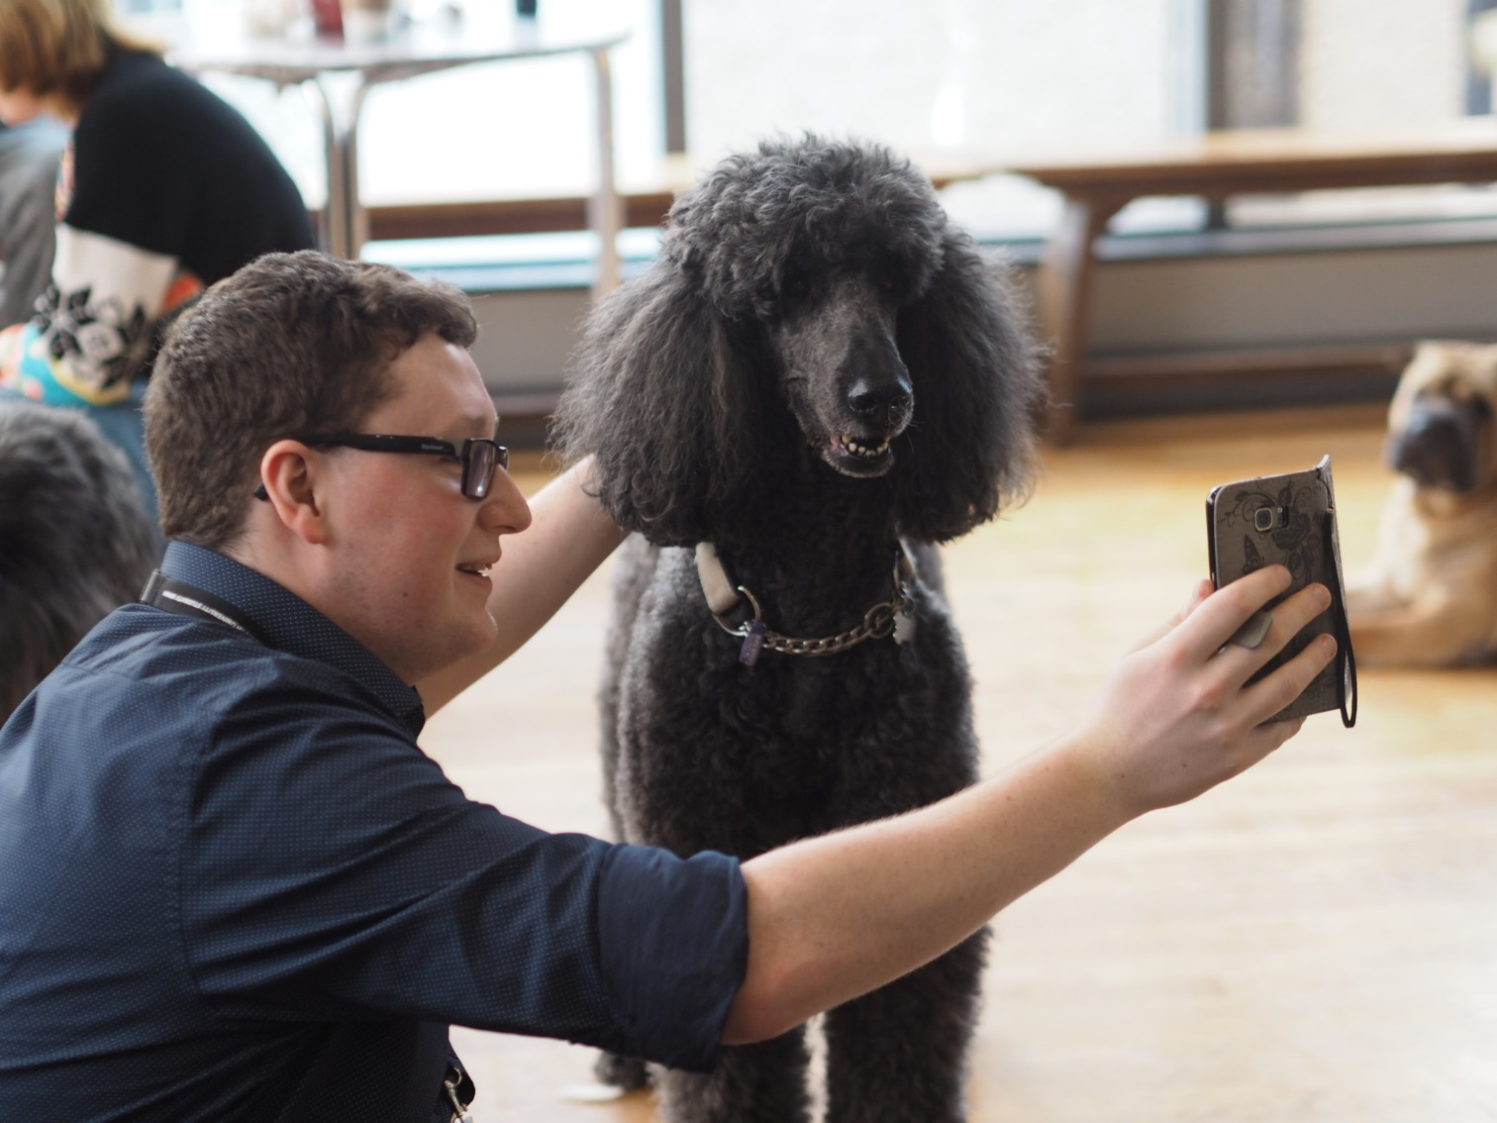

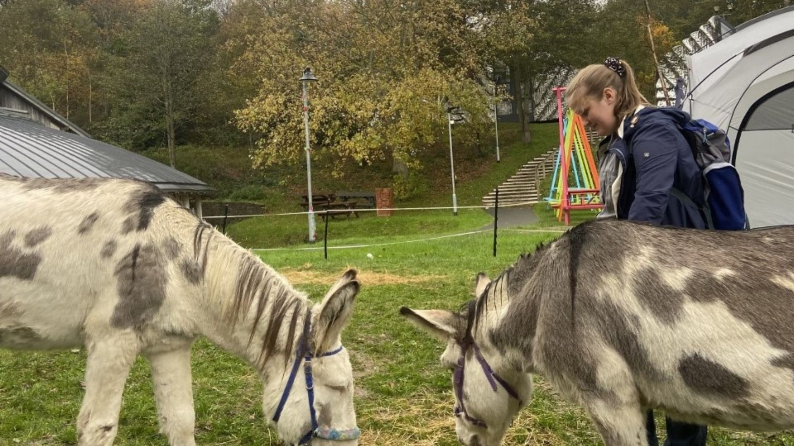
PROMISE 3:
We will support you to be happy and healthy
“We know that life has its ups and downs and we want to be there with you through thick and thin.”
University
Money & Student Finance
Housing &
Accommodation
Health & Wellbeing
Next Steps
EXAM DE-STRESS CAMPAIGN
Dyfi Donkeys / Advice drop ins / Arts, crafts & board games
Peer support.
Resilience skills.
Suicide prevention.
& more
www.abersu.co.uk/advice

Slide 9


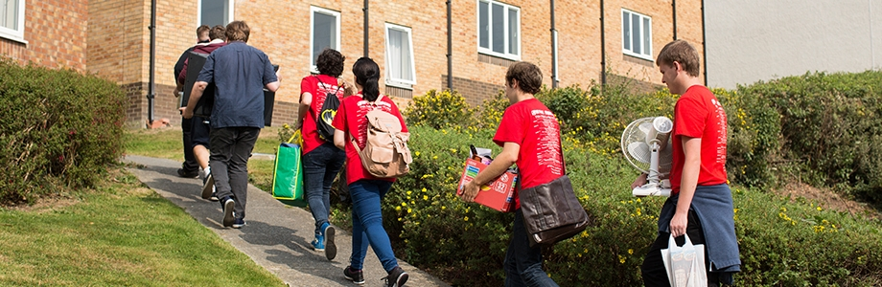

PROMISE 4:
We will help to grow your skills and experiences
VOLUNTEERING AT ABERSU IS EASY.
www.abersu.co.uk/teamaber/volunteering
Search for an opportunity
Register
Volunteer
Log your hours
8,823
Volunteering hours completed by our team of volunteers

Slide 10

Students lead the students’ union
8,000 Students
250 Academic reps
600 Sports & Society leaders
11 Volunteer officers
5 Full time officers (paid)
1 AberSU

Slide 11

Diolch / Thank you
@UndebAber
www.umaber.co.uk / www.abersu.co.uk

