Slide 1
Intro to
AberSU

Slide 2
Contents:
Welcome
About our members
Meet the team – Staff
Meet the Team - Officers
Strategy
Decision making
Political Policies
Operating Policies and procedures
An average year
Benchmarks and awards

Slide 3
WELCOME
Led by students and supported by a team of staff, Aberystwyth Students’ Union wants Aber students to love student life. We strive to ensure that Aber students have an epic student journey, are happy, healthy and empowered, with lasting friendships and promising futures. All students at Aberystwyth University are automatically a member of AberSU.
We provide students with a range of benefits and opportunities to get involved in, including:
Helping students to meet new people, make friends and build communities
Supporting and developing student Sport Clubs and Societies
Supporting, training and working with Academic Reps to have a positive impact for students at course level
Free, impartial, friendly and confidential advice
A representative voice for all Aberystwyth University students
Opportunities for students to campaign on the issues they care about
Spaces to study, meet and socialise
We are a democratic, charitable organisation and have a responsibility to act ethically and responsibly in all that we do, contributing to the wider community and limiting our impact on the environment.
We hope that you will enjoy working as part of our sharing and supportive team and that you grow and develop existing and new skills and abilities along the way.

Slide 4
ABOUT OUR MEMBERS*
Age
Level of study
Mode of study
Sex
Ethnicity
Nationality
Declared disability
*approx.
7,500 students

Slide 5
MEET THE TEAM: STAFF
Key departments:
Support &
Representation
Student
Opportunities
Communications &
Engagement
Advice | Exec Team Student Reps
Student Officers Campaigns
Research & Consultation Elections
Decision making
Volunteering
A-Team
Societies & Sports team (BUCS) development and support
Superteams, Aber7s, Varsity
Coaching and development
Website & Social media
Marketing income
Brand guidelines
Public relations
Event support
Insight
Translation
Plus Finance & Leadership
Includes Reception

Slide 6
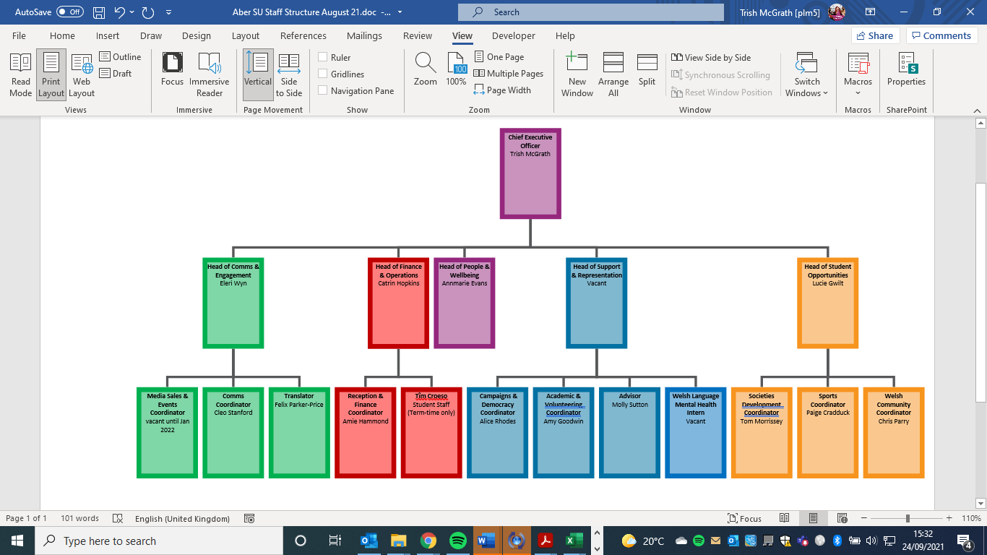
MEET THE TEAM: STAFF

Slide 7
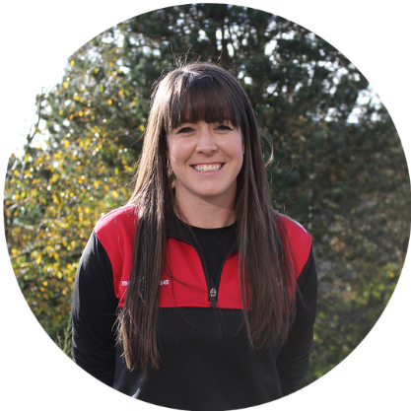
MEET THE TEAM: STAFF
Name: Lucie Gwilt
Role: Student Opportunities Manager
Purpose: To support, enable and empower students to develop and access a rich and diverse range of extra-curricular opportunities which will add value to the student experience, promote student community support & integration, and the development of friendships, skills and memories that last a lifetime.
Key activity: Manage the day to day running of the opportunities office. Oversee all major sports and societies events inc Awards, Superteams, Activities Week, Aber7’s and Varsity

Slide 8
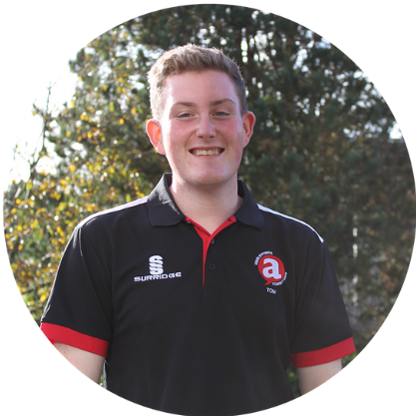
MEET THE TEAM: STAFF
Name: Tom Morrissey
Role: Societies Development Coordinator
Purpose: To promote student participation in societies, for the purposes of growing shared interest communities, developing transferrable skills, and providing valuable extra-curricular opportunities for members.
Key activity: Working to support Societies, vehicles, Society development, facilities and transport booking, Superteams, Aber7’s and Socs Fest

Slide 9
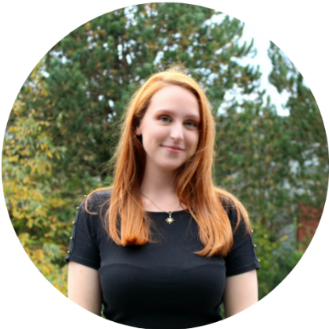
MEET THE TEAM: STAFF
Name: Paige Cradduck
Role: Sports Coordinator
Purpose: To promote student participation in sporting activities, including local, regional and national competition, for the purposes of growing shared interest communities, promoting a healthy student lifestyle and providing valuable extra-curricular opportunities for members.
Key activity: Working to support sports teams, BUCS administration, vehicles, Club development, facilities and transport booking, Superteams, Aber7’s and Varsity

Slide 10
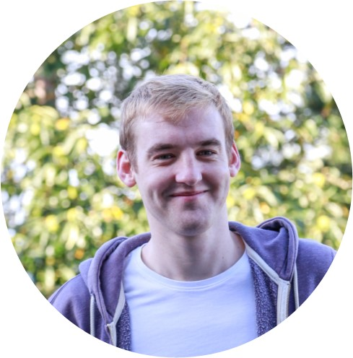
MEET THE TEAM: STAFF
Name: Chris Parry
Role: Welsh Community Coordinator
Purpose: to promote student participation in Welsh language activity, for the purposes of growing shared interest communities, developing transferrable skills, and providing valuable extra-curricular opportunities for members. To work closely with the UMCA President and Welsh Culture Officer to support the administration, and development of UMCA and associated groups to ensure that they run safely, sustainably and effectively.
Key activity: Working to support UMCA to coordinate meetings and events, to work with the UMCA President and group leaders to develop Welsh language community activity to engage a diverse range of Welsh speaking students.

Slide 11
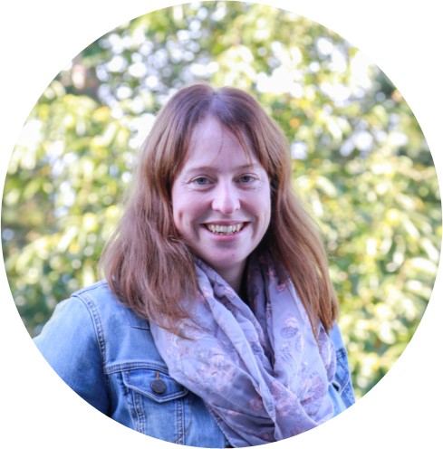
MEET THE TEAM: STAFF
Name: Catrin Hopkins
Role: Finance Manager
Purpose: To oversee the management, delivery and development of AberSU’s finance activity, managing resources, ensuring that appropriate protections are in place, and reporting financial performance and information.
Key activity: Ensuring all invoices and income are on the system correctly in order to provide accurate information in monthly Management Accounts, every quarter I do VAT and all of this concludes with the end of year tasks ahead of the yearly audit. I also make sure that there is always Milk in the Fridge for Tea and coffee but anyone is welcome to pop to Tesco instead of me to fetch some (Monday or Tuesday).

Slide 12
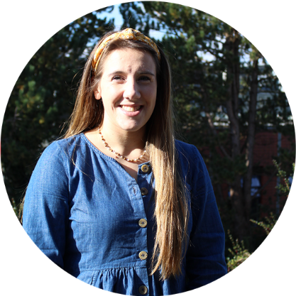
MEET THE TEAM: STAFF
Name: Amie Hammond
Role: Reception and Finance Coordinator Coordinator
Purpose: To act as a welcoming and friendly first point of contact for students, staff and visitors entering or contacting the Students’ Union; providing information about the Union’s services and facilities, you will be responsible for ensuring that all users receive the best possible service. To provide high quality support for the secure and effective management of AberSU’s resources, and the effective implementation of finance-related policies and practices to support the organisation’s aims.
Key activity: Administering club/society accounts, processing and admin for finance, dealing with general queries at reception and on email, selling Bus cards and NUS cards, post, room bookings.

Slide 13
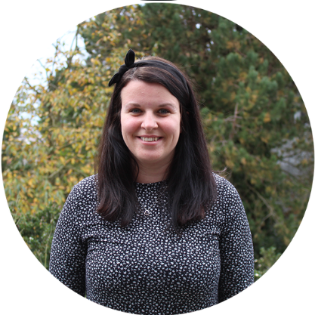
MEET THE TEAM: STAFF
Name: Eleri Wynn
Role: Communications & Engagement Manager
Purpose: To oversee the management, delivery and development of AberSU’s Communications and engagement activity. To ensure that AberSU’s members and stakeholders are aware of, engaged with, and understand the value of the services, activities and opportunities available to them and the positive impacts achieved for them, through and by Aber SU as a membership organisation.
Key activity: Coordinating and supporting SU wide marketing and Comms, Website, Wall planner and handbook, responsible for marketing income, coordinating and supporting press enquiries and publicity. Coordinating design and translation services. Social media.

Slide 14
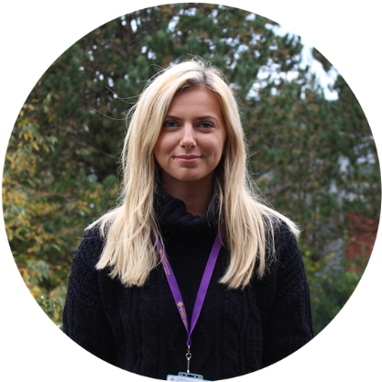
MEET THE TEAM: STAFF
Name: Cleo Stanford
Role: Communications Coordinator
Purpose: To coordinate the AberSU portfolio of communications mechanisms, to promote high quality member and stakeholder engagement as a membership organisation. Responsible for developing, maintaining and delivering our communications work by creating engaging content that works to enhance the relationship between students and the Union. Advising Union staff and officers on how best to communicate their messages to students.
Key activity: Coordinating and supporting SU wide marketing and Comms, Website, Wall planner and handbook, responsible for marketing income, coordinating and supporting press enquiries and publicity. Coordinating design and translation services. Social media.

Slide 15
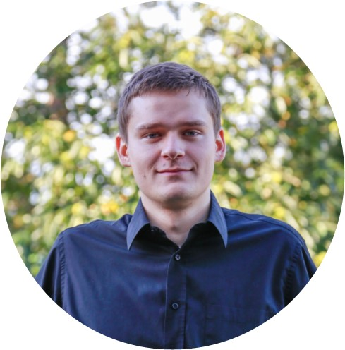
MEET THE TEAM: STAFF
Name: Matt Lukasiak
Role: Media Sales and Events Coordinator (on a career break until Feb 2022)
Purpose: To co-ordinate and drive sales revenue directly through the sale of media and sponsorship opportunities aimed at our student members, including advertising in Students’ Union publications or online channels, on-site exhibition activity and
sponsorship of activities and events. To provide relevant and valuable opportunities for students to engage with local, regional and national service providers, generating income and building positive relationships for AberSU.
Key activity: Coordinating and supporting SU wide marketing advertising and sales income and relevant events.

Slide 16
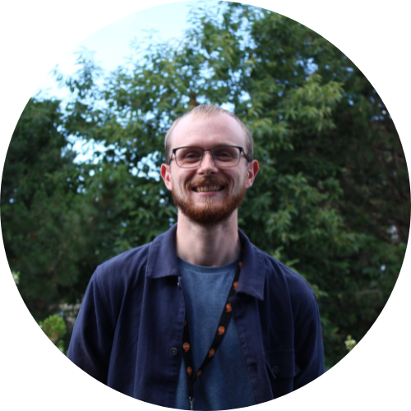
MEET THE TEAM: STAFF
Name: Felix Parker-Felix
Role: Translator (Intern)
Purpose: To translate a variety of documents from English into Welsh and vice versa.
To provide a simultaneous translation service from Welsh into English and vice versa at meetings as required.
Key activity: Written translation of a variety of formal and informal documents and text, including social media, marketing and promotional assets, website content, reports and governance documents. Simultaneous translation at a variety of meetings

Slide 17
MEET THE TEAM: STAFF
Name: Vacant
Role: Support and Representation Manager
Purpose: To oversee the management, delivery and development of AberSU’s Advice Service and high quality democracy and representation provision. To empower students to shape their Students’ Union and enhance their University experience and ensure that AberSU is the primary voice of students.
Key activity: Officer Induction, Training and Support, Campaign Planning and Delivery, Council & AGM, Teaching Awards, Volunteer Training and Support. PT Officers, Academic Reps, Institute Reps etc. etc. Ensuring Quality of Advice / Support provided by Union and How we almost definitely first met... Elections!

Slide 18
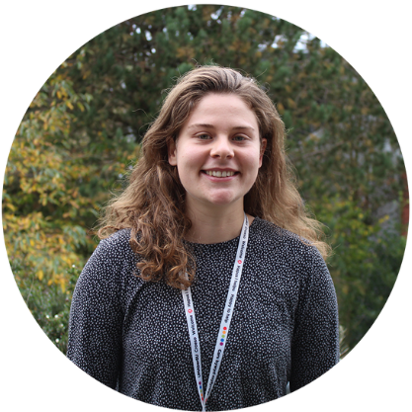
MEET THE TEAM: STAFF
Name: Alice Rhodes
Role: Campaigns & Democracy Coordinator
Purpose: To ensure that the Students’ Union is empowering students and student representatives to have a strong voice that shapes the Students’ Union, their educational experience, and that is heard locally and nationally. To support and enable student representation, in particular through the course level representation scheme, AberSU democratic channels, upholding principles of democracy. To be an active outreach member of staff that is proactive in going out to talk to students about their experiences and views.
Key activity: Elections, AGM, Council, Officer campaign support, outreach student voice work

Slide 19
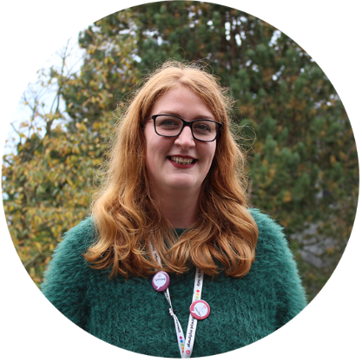
MEET THE TEAM: STAFF
Name: Molly Sutton
Role: Student Advisor
Purpose: To provide high quality, independent information, advice and advocacy, primarily for members in dispute with Aberystwyth University, and to ensure effective signposting to alternative support as required. To report key data to management and representatives to support the development of AberSU policy, campaigns and representation.
Key activity: One to one case work, supporting students with Uni processes: appeals, complaints, disciplinaries, unacceptable academic practice etc. Housing and money advice, general advice. Advice campaigns e.g national student money week, reporting on trends for policy work.

Slide 20
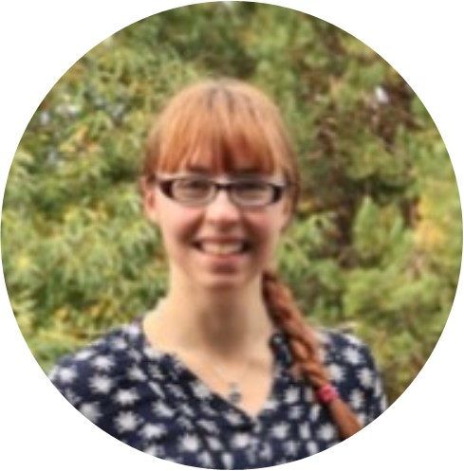
MEET THE TEAM: STAFF
Name: Amy Goodwin
Role: Academic & Volunteering Coordinator
Purpose: To support and enable student participation in volunteering, particularly to empower students to
shape their educational experience, developing transferable skills and providing valuable extracurricular opportunities for members. To build links with local Community organisations to connect
student volunteers to projects that benefit the wider Aberystwyth Town and University Community.
To be an active outreach member of staff that is proactive in going out to talk to students about
volunteering and academic representation
Key activity: Working with and supporting Reps and Faculty Officers, Rep elections, Teaching awards, A-Team, Volunteering

Slide 21
MEET THE TEAM: STAFF
Name: Vacant
Role: Welsh Language Mental Health Coordinator
Purpose: Funded by Higher Education Funding Council Wales (HEFCW), Aberystwyth University are a collaborative partner on a project to Improve Mental Health and Well-being support for students through the medium of Welsh.
Key activity: The project involves the development and provision of sustainable support for improving mental health and well-being for students for whom Welsh is their first and preferred language, including the development and creation of online resources, and an All-Wales Welsh Language Mental Health Practitioners and Therapists Network. The project will bring about a significant step forward in providing equivalency for Welsh speaking students.

Slide 22
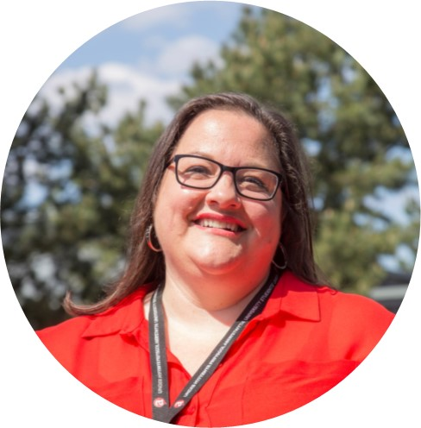
MEET THE TEAM: STAFF
Name: Annmarie Evans
Role: People & Wellbeing Manager
Purpose: To ensure that all staff related activity is conducted in line with the Union policy & procedures and that all policy & procedures are maintained in line with legislation and best practice. To oversee key organisational processes such as learning & development
activity, staff wellbeing, and the induction programme. Maintain a detailed knowledge of health and safety, duty of care, safeguarding and regulatory issues relating to Students’ Union compliance in these areas.
Key activity: HR Admin, supporting meetings and performance management, Trustee Board support, supporting the CEO and Officers, Staff Handbook and policy, inductions.

Slide 23
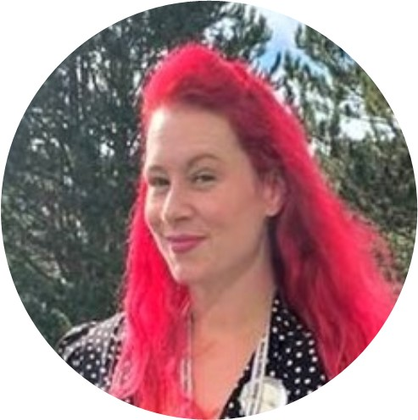
MEET THE TEAM: STAFF
Name: Trish McGrath
Role: CEO
Purpose: Overall strategic and general management of AberSU and corporate responsibility for the delivery of the Union’s purpose, vision and values, and strategic plan. To act as the most senior member of staff to lead the executive functions of the organisation and its resources to meet the demands of Aberystwyth University students now and in the future, taking direction from the Board of Trustees to achieve this and working with the University and other stakeholders.
Key Activity: Lead the staff team and ensure that the Students’ Union is legally, financially and reputationally sound. Guide Officers to achieve their best representing students. Ensure that we operate within best practice where possible.

Slide 24
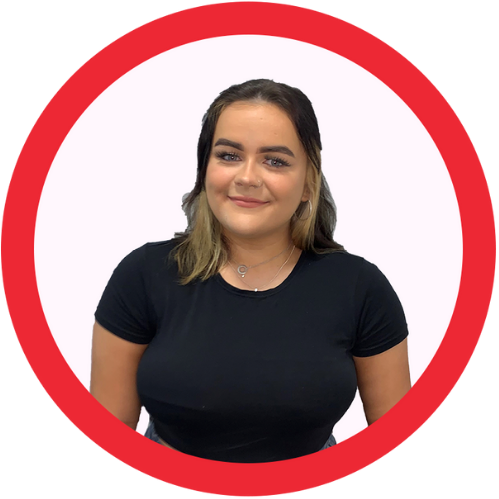
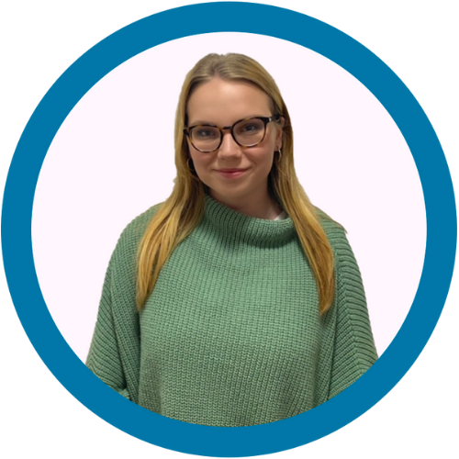
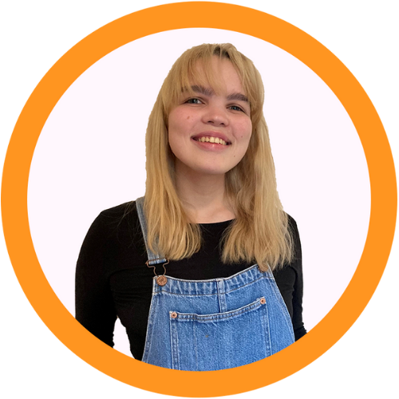
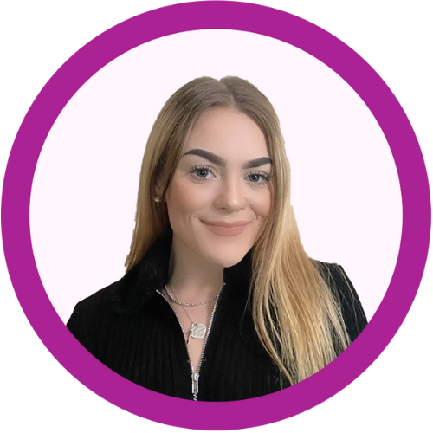
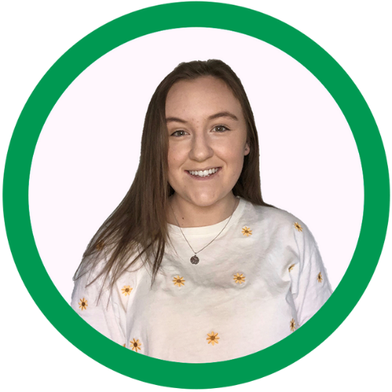
MEET THE TEAM: OFFICERS
Full time Officers are elected in an all student online vote and hold their positon for 12 months starting July each year
President: Sabina O'Donoghue
responsible for: Primary Spokesperspon, democracy, governance, external relations
Academic Affairs Officer: Elizabeth Manners
responsible for: education policy, course representatives, academic campaigns
Student Opportunities Officer: Rachel Barwise
responsible for: sports, societies, volunteering, skills development
Wellbeing Officer: Hannah Lunnon
responsible for: wellbeing, finance, wellbeing campaigns inc. housing
Welsh Culture Officer & UMCA President: Mared Edwards
responsible for: Welsh language & culture, welsh lang education, UMCA

Slide 25
MEET THE TEAM: STAFF PRINCIPLES
We put students first
We care about our happiness and wellbeing
We collaborate as a team
We are reliable and trust each other
We are ambitious and develop ourselves and
each other

Slide 26
STRATEGY

Slide 27
STRATEGY: MONITORING PROGRESS
The Students’ Union is monitors progress against our strategy in a number of key documents including an annual operating plan and a KPI (Key performance indicator) dashboard that is accessible to all staff. These can be found on the Strategy and KPI pages of the staff website
If you can’t access these please let the CEO know an email you use for google docs and they will enable access for you.

Slide 28
DECISION MAKING
The Students’ Union is governed by overall policies/bye-laws outlined in our Constitution.
As a registered Charity the Students’ Union is governed and strategically led by the Board of Trustees. They are ultimately responsible for making sure that we operate in line with our charitable objectives. AberSU Trustee Board is made up of 12 members and meets at least four times a year
The Board is made up of:
5 Full Time Officer Trustees
2 Student Trustees
5 External Trustees
However, there are a number of protections in place to support Trustees to consider overall and high level impact and activity to protect student ability to define the political goals (policies) as members. The constitution outlines in detail how each aspect of decision making works but in brief Political decisions are made by students who can also set the direction for any aspect of the SU but all decisions and actions must be agreed by our Trustee Board.
Students largely make decisions by submitting ideas to our Senedd which are then voted on by our elected Senedd members

Slide 29
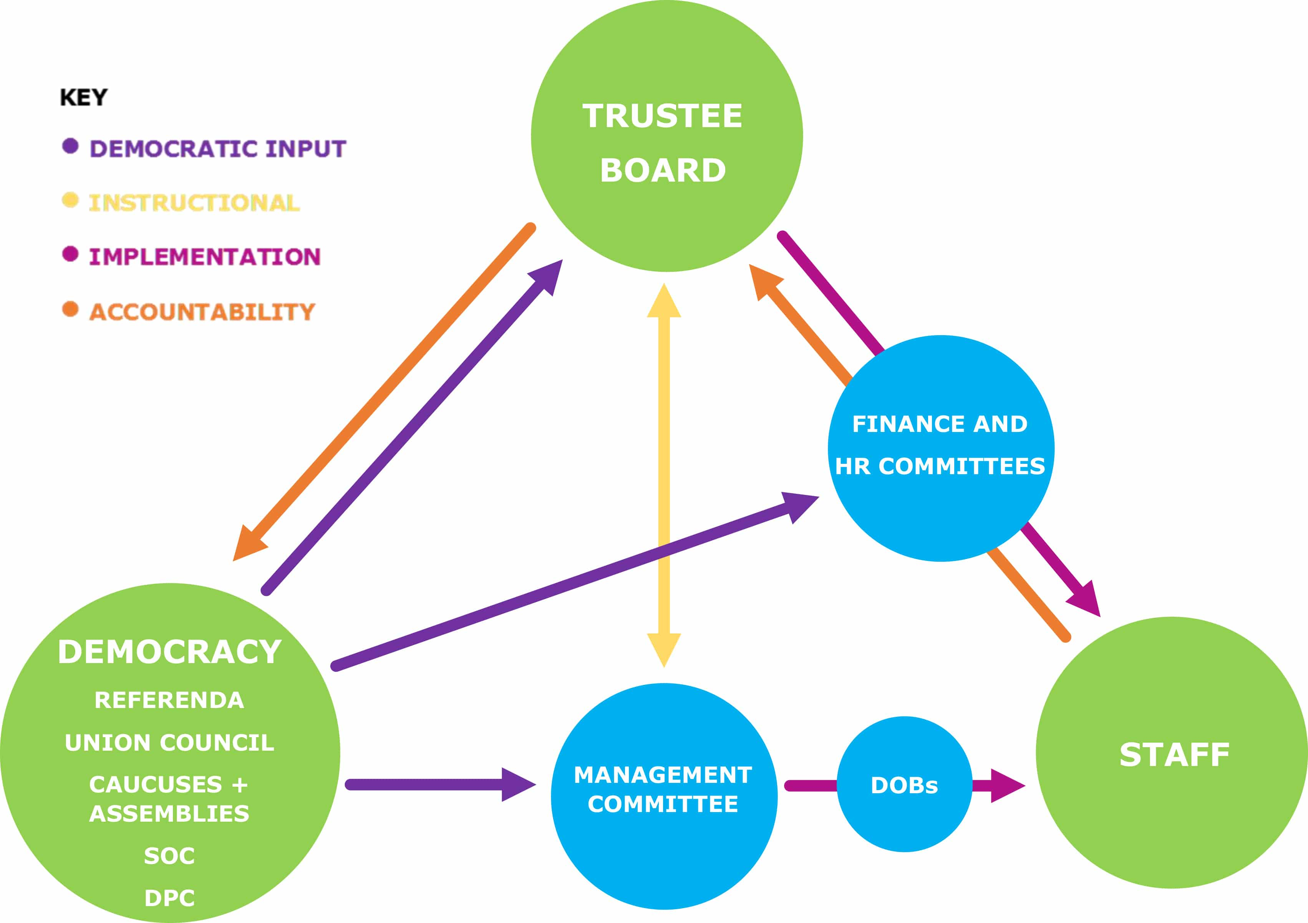
DECISION MAKING
c7500 students
Zones:
FT Officer accountability, general discussion and idea shaping groups
Senedd (SU policy making body):
5 Full Time Officers, 9 Volunteer Officers, 6 Faculty Reps
2 UMCA Exec, 5 Sports Clubs Reps, 5 Societies Rep
All students can submit ideas, attend and debate
Only the roles listed above can vote
FT Officers:
Academic Affairs
Student Opportunities
President
Wellbeing
Welsh Culture
Board of Trustees:
5 Full Time Officers, 1 elected UG, 1 elected PG, 5 Externals
Staff

Slide 30
POLITICAL POLICIES
Policy sets out what AberSU believes and works on; submitted as an idea it is then discussed by Union Council where it can either be passed or sent forward to be voted on by all Aberystwyth students in an All Student Vote.
Passed policy will remain active for up to three years unless it is completed, amended or renewed.
A full list of current Policies can be found online here

Slide 31
OPERATING POLICIES AND PROCEDURES
The Students’ Union has an in depth staff handbook which outlines all relevant processes and procedures that affect employees.
These can all be found online on the staff pages of the SU website along with other key areas of information and links to strategy and impact measuring files

Slide 32
AVERAGE YEAR
The SU operates strategically in academic years rather than calendar years. In general there are a number of key elements of the average academic year to be aware – a full plan for the current year can be found here*
July
New FT Officers start there role and have intro training
Graduation
Planning and prep
August
Planning and prep
September
Majority of students arrive for the start of Semester one
Freshers week and Freshers Fair
October
First set of democratic meetings
Rep and vacant role elections
Homecoming event
November
Aber Challenge
Second set of democratic meetings
December
End of Semester 1
January
Exams
Planning and prep
Refreshers
February
Superteams
Third set of democratic meetings
March
Main SU elections (FT roles)
Fourth set of democratic meetings
April:
Varsity & Socs Fest
May
Aber 7s
Awards (or in April depending on Easter)
Exams
June
Planning and prep
* Plans are subject to change

Slide 33
BENCHMARKS AND AWARDS
The Students’ Union has taken part in a number of benchmark/development schemes and we’re proud to have been successful in gaining a number of awards.
Benchmarks
2020: Chwarae Teg Fairplay Employer Scheme – Leading level awarded
2019: NUS Quality Students’ Unions
Awards
2020: Chwarae Teg Diversity Champion Award winner
2019: Aberystwyth University St David’s Day Award – Promoting Welsh in the Workplace
2019: NUS Wales Awards – Officer Team of the Year winner
2018: NUS Awards: The People Award winner
2018: NUS Awards: The Democracy Award winner
2018: NUS Wales Awards: Student Opportunities Award winner

