Slide 1
2023 OFFICER
ELECTIONS
CANDIDATE BRIEFING
umaber.co.uk | abersu.co.uk

Slide 2
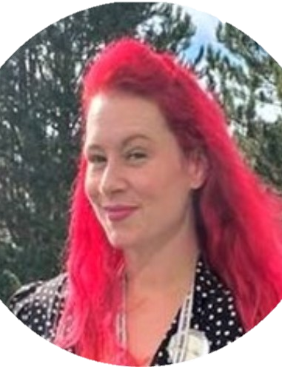
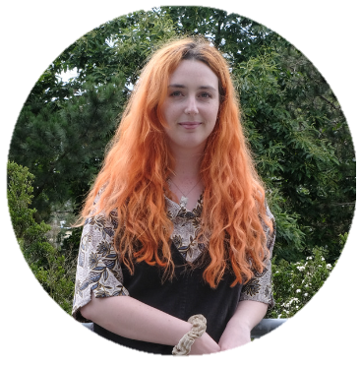
Your Elections Team
Jacob Webb, Deputy Returning Officer
Trish McGrath
Aisleen Sturrock
NUS Charity, Returning Officer
umaber.co.uk | abersu.co.uk

Slide 3
CONGRATULATIONS ON STANDING FOR ELECTION

Slide 4
Coming up…
Key Dates
Expected Behaviours
Candidate Rules
Complaints
Voting Process
Candidates Standing
Campaign Expenses / Materials
Campaigning Guidance
Candidate Wellbeing
Q&A

Slide 5
Introductions
1
What is your name?
2
What position are you standing for?
3
What made you decide to stand?

Slide 6
Why do we have elections?
We aim to elect people in a free and fair manner.
Elections are the mechanism for our members (students) to choose their representatives.
Wherever possible members (students) should always decide/be the decision makers.
We are not here to give everyone an equal chance of winning, just a fair one.
We are shaped by students - Your voice matters most

Slide 7
Key Dates: 2023 Spring By-elections
Standing Deadline – 12pm Tuesday 18th April
Publicity Deadline – 12pm Tuesday 18th April
Voting Opens – 12pm Monday 24th April
Voting Closes – 3pm Wednesday 26th April
Expenses Deadline - 4pm Wednesday 26th April
Complaints Deadline - 4pm Wednesday 26th April
Results – 5pm [approx.] Wednesday 26th April

Slide 8
Expected behaviours: Be Kind
Positive vs Negative campaigning.
Challenge policies not individuals.
Be mindful of others.
Starting as you mean to go on.

Slide 9
CANDIDATE
RULES
umaber.co.uk | abersu.co.uk

Slide 10
Why do they exist?
Designed to help create a “level playing field” between candidates.
There are limits though... Friends (Online and Offline).
Attempt to control behaviour and use of resource without stifling creativity.
Wider existing laws which govern individual student behaviour remain.
A sense of fair play and friendly competition reflects best on you and the process as a whole – and gets more voters!

Slide 11
The Rules – Key Principles
Do only what other candidates have an equal opportunity to do;
Treat all students, candidates and staff members with respect.

Slide 12
The Rules – What not to do
Use University or Students’ Union resources including email lists (except where explicitly permitted by the Deputy Returning Officer).
Deface, tamper of interfere with another candidates publicity.
Bribe voters or election officials.
Threaten or harass voters or election officials.

Slide 13
The Rules – What not to do
Produce offensive or defamatory publicity.
Prevent the free and confidential exercise of a vote by voters, including the improper use of devices.
Compromise or interfere with the integrity of the election.
Cast a vote on another person’s behalf
Notes:
Electoral Integrity
There is an ongoing debate over a single, universal definition of electoral integrity, but it can generally be defined as "any election that is based on the democratic principles of universal suffrage and political equality as reflected in international standards and agreements, and is professional, impartial, and transparent in its preparation and administration throughout the electoral cycle." (Kofi Annan Foundation, 2012)

Slide 14
The Rules – Current Full Time Officers
Must take leave if they wish to undertake campaigning during normal office hours.
May not use any of the resources of their current position to assist any election campaign.

Slide 15
The Rules – Campaigns Team
Campaigns Team = “Campaigners who assist you during the election”.
Campaigner = “Someone who would be reasonable thought to be acting on behalf of a candidate to further the election of that candidate”.
Campaigning = “Work in an organised and active way towards a particular goal, typically the election of a candidate”.
You are responsible for their actions.

Slide 16
In summary…
Fair – The election will be by secret and consenting ballot.
Independent – AberSU will not endorse any candidate.
Respect – AberSU expects all students and staff to be treated with respect.
Fun and positive – We want it to be an experience everyone enjoys.

Slide 17
ELECTION
COMPLAINTS
umaber.co.uk | abersu.co.uk

Slide 18
Complaints
Must be submitted using the complaints form on the elections pages of the SU website. We CANNOT accept complaints in person.
If necessary the DRO will investigate to obtain further evidence.
The RO (NUS Elections Support Service) will rule upon complaints.
Can’t count votes until all complaints have been dealt with.
Complaints must be timely and in good faith – deadline for all complaints is 4pm, Wednesday 26th April
Notes:
https://umabersu.wufoo.com/forms/z1qpaxxv0rqd6n8/

Slide 19
Results, penalties and appeals
If no penalties are applied to any candidates:
Count can only commence when all complaints are resolved.
Results will be announced online at approximately 5pm, 26th April
Where penalties have been applied:
Results will not be announced until all appeals have been resolved.
Disqualified candidates will be informed first.
Candidates for each position will be informed privately.

Slide 20
Appeals
Must be submitted in writing by email to union.elections@aber.ac.uk.
Where it relates to a candidate only someone in receipt of a penalty can appeal.
Must specifically state the ground on which the appeal is being made.
Must be submitted no later than 12pm on the day after the RO has ruled on a complaint.
A panel will be convened including the University Secretary and two independent members.
The appeals panel’s decision is final.

Slide 21
CANDIDATES
STANDING
umaber.co.uk | abersu.co.uk

Slide 22
Candidates
Independent Students’ Officer
Gareth Griffiths
RON
Faculty of Business and Physical Sciences (FBPS) Officer (UG)
Jack Lynock
Saffron Luxford
Terry Hand
RON
Faculty of Business and Physical Sciences (FBPS) Officer (PG)
RON
Faculty of Earth and Life Sciences (FELS) Officer (UG)
RON
Faculty of Earth and Life Sciences (FELS) Officer (PG)
Fflyff McLaren
RON
Faculty of Arts and Social Sciences (FASS) Officer (PG)
Tristan Wood
RON

Slide 23
Candidates
Undergraduate Student Trustee
Daniel Bradley
Tom Molyneux
RON
Postgraduate Student Trustee
RON

Slide 24
VOTING
PROCESS
umaber.co.uk | abersu.co.uk

Slide 25
The wonders of transferable votes
Elects the “least unpopular” candidate.
Voters rank their candidates in order of preference.
If I can’t have Jane (#1), I’ll have Tom (#2), if neither Alan (#3).
Sometimes called Single Transferable Vote (STV) or Alternative Transferable Vote (ATV).

Slide 26
Round 1 - Everyone Loves Lucy
umaber.co.uk | abersu.co.uk

Slide 27
Round 2 – Here Comes Ben
umaber.co.uk | abersu.co.uk

Slide 28
Round 3 – Poor Lucy!
umaber.co.uk | abersu.co.uk

Slide 29
How students vote?
Voting takes place via the Student’s Union website.
Any issues direct students’ to union.elections@aber.ac.uk

Slide 30
CANDIDATE
EXPENSES/ MATERIALS
umaber.co.uk | abersu.co.uk

Slide 31
Campaign Expenses – Monies & Receipts
Maximum spend £30 Full Time Officer candidates & £20 Volunteer Officer and Student Trustee candidates.
Those standing as a pair are considered a single candidate.
All receipts submitted by 4pm on Wednesday 26th April (proforma available on Elections Hub).

Slide 32
Campaign Expenses 2023
Free black and white printing – A6, A5, A4 and A3
Submit requests to union.elections@aber.ac.uk for collection from reception the next working day
Colour printing to come from candidate budget A4 5p / A3 10p
T-shirts? Badges? Stickers?

Slide 33
Publicity on campus
Do not block or reduce visibility of pedestrians near roads
Do not block fire exits or doorways
Posters cannot be displayed in outlets / restaurants. (Poster wall in the Union bar)
Leaflets can be left on tables but may be removed
No staff on duty can wear promotional materials
If in doubt always ask

Slide 34
Campaign Ideas 2023
Some other ideas include…
Use Facebook advertising to promote your campaign page.
Work with friends or campaigns team to make an eye-catching elections video.
Host or live stream content promoting your campaign.
Encouraging sharing of themed posts or content.

Slide 35
Campaign Expenses - Printing
As much as possible we want to encourage limited printing to reduce our paper consumption.
However, we recognize that you may well choose to print a few well considered posters or flyers.

Slide 36
Campaign Expenses - Printing
The cost of printing from non–SU printers should be accounted as follows:
1x A4 Black and White 3p / Colour 5p
1x A3 Black and White 5p / Colour 10p

Slide 37
Candidate Expenses - Materials
Remember there are lots of free online resources available to all candidates…
Canva – www.canva.com (cannot use a paid society/club account)
Later – www.later.com
Hootsuite – www.hootsuite.com
Powtoon – www.powtoon.com
Office 365
Google Docs/Sheets/Slides/Forms

Slide 38
Translation
Translation is available to candidates via the Union’s translation service.
Please note this service will be in heavy use over the election period and requests may take longer than usual…
Translation of Publicity and Summaries will be prioritised.
If you would like to request translation please email your text to union.elections@aber.ac.uk noting the total word count of your request.
Top-tip… keep it short and concise for a quicker turnaround!
Deadline – 12pm Friday 21st April 2023

Slide 39
CAMPAIGNING
GUIDANCE
umaber.co.uk | abersu.co.uk

Slide 40
Slates and joint campaigning
Slates are OK!
Joint publicity is OK!
Pairs treated as single candidates
No combined spending.
No pooled items.
No bulk discounts more than an individual could get.

Slide 41
Campaign Teams
You are responsible for their actions.
Gather a wide range/strong personalities.
Do you allocate responsibilities or tasks?
Have regular meetings with them.
Support them, encourage them and thank them!

Slide 42
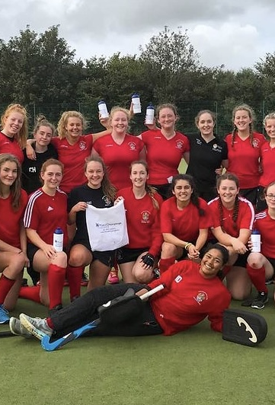
Sports Clubs and Societies
Sports Clubs and Societies can support you.
Cannot spend money or resources on your campaign.
No conflicts of interest – remember to only do what others have the opportunity to do.
Endorsement must be done in accordance with Clubs and Society’s usual decision making processes and you must be able to evidence if asked.
It is in your interest to ensure processes are followed.
umaber.co.uk | abersu.co.uk

Slide 43
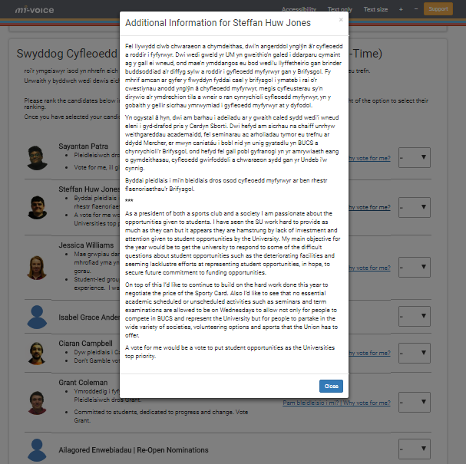
Publicity & Summary
“I read their publicity” biggest reason why voters voted.
Simple, specific and structured – the rule of three.
Get feedback.
Learn it in full.
umaber.co.uk | abersu.co.uk

Slide 44
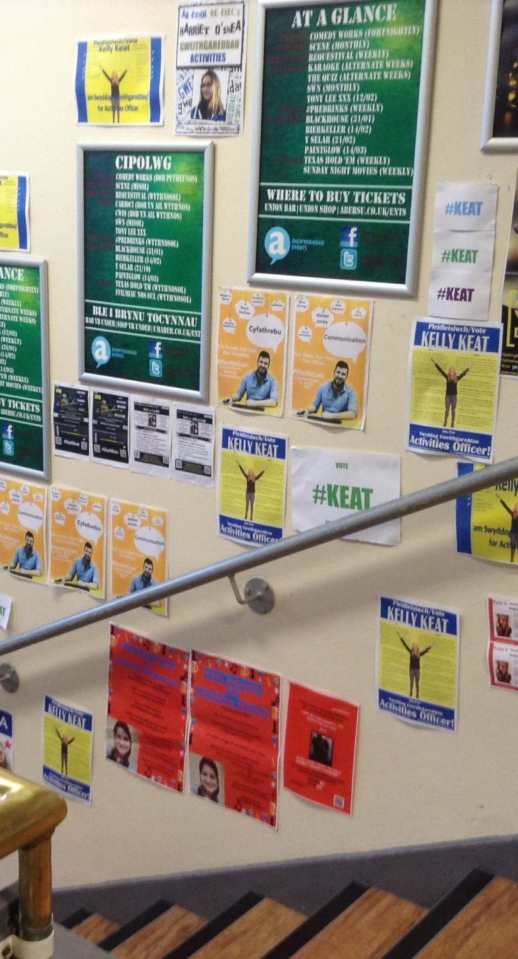
Tell them what they need to know
Your name, the position.
To vote you #1.
Where and how they can vote.
The dates.
umaber.co.uk | abersu.co.uk

Slide 45
60 second summaries
Video of each candidate giving their 60 second pitch as to why they would be a good fit for the role they are standing for.
Videos will be made between the close of standing (Wednesday February 22nd) and Friday March 3rd.

Slide 46
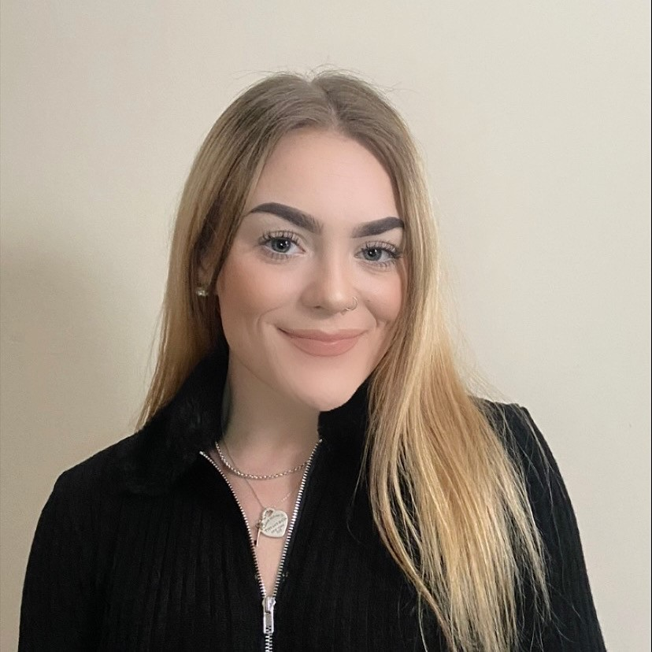
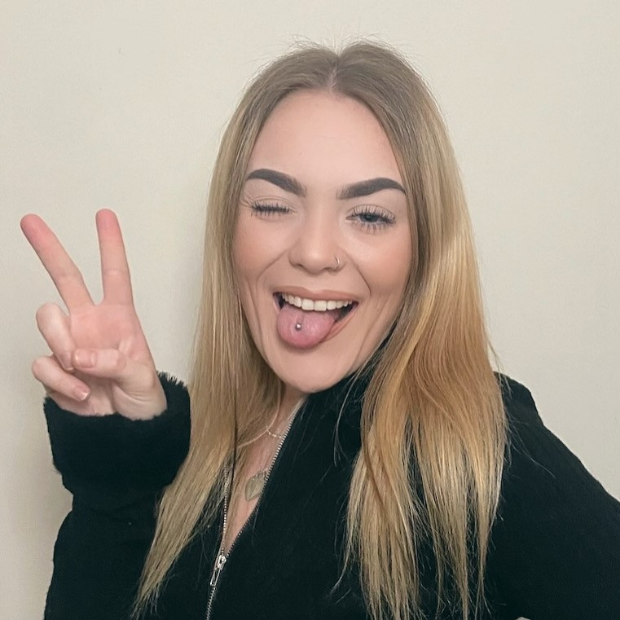
Photos!
To be taken today!
x2 photos – one plain and one fun, both taken against a white wall and ideally from the shoulders and above well-lit area (Do not wear any items of clothing with the Union or University logo).
Taken

Slide 47
Speak to students
“Voters contacted face-to-face were 21 percentage points more likely to vote for the candidate after speaking with them for fewer than 10 seconds, compared with those left alone”
“The experiment found that voters called on the phone or sent postcards were not noticeably more likely to vote than those sent nothing. But canvassing was different. Just one in-person conversation had a profound effect on a voter’s likelihood to go to the polls, boosting turnout by a whopping 20 percent (or around 9 percentage points)”
“We find that a brief visit by the candidate dramatically increases the support for the candidate regardless of the nature of the message delivered. The actions of candidates seem to speak louder than words”
Royal Economic Society

Slide 48
CANDIDATE
WELLBEING
umaber.co.uk | abersu.co.uk

Slide 49
Self care is crucial
Make sure you get 7-8 hours sleep a night.
Plan rewards and times to switch off from elections.
Complete urgent work before voting opens so that you can prioritise your campaign during voting week.
Plan to win but be prepared to lose – plan post elections.
Know and prioritise your individual needs

Slide 50
Considering withdrawing?
Be clear on why.
Rationalise with if you were applying for a job.
Discuss with someone beforehand.
Consider remaining on the ballot.
24 hour cooling off period for all candidates.

Slide 51
Results
Wednesday 26th April March, 5pm approximately.
Online – pending outcome of complaints.

Slide 52
QUESTIONS? ☺
EMAIL: union.elections@aber.ac.uk OR jaw151@aber.ac.uk

