Slide 1
OUT AND PROUD! Sex without the shame – redressing queer (dis)engagement with sexual health services
Matthew James Townsend
Lecturer, Healthcare Education Department
Aberystwyth University
E: mat109@aber.ac.uk
Student’s Union, Nov 2023

Slide 2
Objectives –
Introduction
Background – We were always here.
LGBTQ+ inclusivity in healthcare
Where did it all go wrong?
“The message is you don’t exist” – Barriers to accessing sexual health services. Rural issues challenging uptake
Queer conversations – research direction
Questions
Notes:
Run through the slide

Slide 3
Openly queer academic – from the Rhondda to Research
Lecturer (Adult Field | Critical Care Nursing (ITU)
Research Interests –
- Reflection as a conduit for clinical excellence
- Death and Dying – the nurse as death professional
- Cultural Competence and Congruence
- LGBTQ+ visibility and inclusivity in healthcare
- LGBTQ+ end-of-life care (#QueerPeopleDieToo)
LGBTQ+ lead for Healthcare Education Department
- Ensuring gender-inclusive indicative curriculum content
- Ensuring a dovetail with WG LGBTQ+ Action Plan for Wales
Notes:
Run through the slide

Slide 4
1861
Death penalty removed.
Replaced with 10 years hard labour + life imprisonment
1970
Gay Liberation Front founded
1533
Buggery Act
Acts of Sodomy moved from ecclesiastical court to the State
1951
First known British transgender woman undergoes sex reassignment surgery
1988
Section 28 brought into law
(enforceable until 2003)
1828
Buggery Act repealed. Replaced by Offences Against the Person Act
1968
WHO lists homosexuality as a
“Mental Disorder”
1921
Attempt to make lesbian acts illegal. Bill rejected by both Houses
1981
First UK case of AIDS
Notes:
Where have we come from, where are we going?
Key dates here –
1533. Buggery Act. Acts of sodomy shifted from ecclesiastical court to the State – stayed with the State ever since. Punishment death.
1861 – Death penalty removed. Replaced with 10 years hard labour and life imprisonment
1951 – First British transgender woman undergoes reassignment surgery – Roberta Coles.
1968 – SIGNIFICANT FOR HEALTHCARE → WHO lists homosexuality as a mental disorder
1988 – Section 28. Conservative government. Was a very small section of the Local Govt Act expressly prohibiting Local Authorities to support LGBT issues → Schools banned from teaching any LGBT content → Funding pulled from Arts projects (The Arts encouraged LGBT) → All educational resources censored and redacted. Remains enforceable until 2003!!!
This occurring alongside the global AIDS epidemic → feelings of shame / living underground and concealed / State-backed censorship of anything diverging from heteronormative constructs

Slide 5
2003
Employment Equality Regulations come into force
2013
Marriage (same-sex couples) Act
Equal marriage rights
2021
Queen Elizabeth II announces Conversion Therapy ban will be brought before parliament “soon”
-
No ban without the trans (2022)
1992
WHO removes homosexuality from its list of mental disorders
2010
The Equality Act
2003
Section 28 repealed (England, Wales, NI)
2011
Gay and Bisexual men can give blood “after 1 year deferral period”
2021
Blood donation law changed for some men who have sex with men
-
Trans people
< 16 yrs can consent to puberty blockers
2004
Gender Recognition Act passed
2020
Same-sex marriage becomes legal in NI
Notes:
1992 – WHO backtracks (but still had 30 years to treat) and removes homosexuality from its list of mental disorders
Key legislation →
2003 – Employment Equality Regulations come into force – now employers couldn’t discriminate and sack you because of your sexual orientation
2004 – Gender Recognition Act → Transgender people now had full legal recognition in their appropriate gender. Trans people could now obtain a revised birth certificate (gender options still limited to Male or Female)
2010 – Equality Act → Legislates for equal treatment in access to employment as well as private and public services regardless of protected characteristics
2013 – Marriage (same-sex couples) Act – Equal marriage rights (reaches NI in 2020)
2011 – Gay men can give blood after one year deferral period
2021 → Conversion Therapy ban will be brought before parliament ‘soon’ → It’s still legal to send your children to conversion therapy (!). The ban did not include transgender children – “No ban without the Trans” 2022
2021 – blood donation law changed for some men who have sex with men (3 month same partner or deferral) | In the same year then, trans people <16 and competent to do so can consent to puberty blockers.
JUST HELPS CONSOLIDATE FOR YOU WHERE WE ARE, HOW WE GOT HERE BUT ALSO WHY THERE IS STILL HUGE HEALTH INEQUALITIES AND BARRIERS TO LGBTQ+ PEOPLE ACCESING HEALTH CARE
As we currently stands, same-sex acts remain criminalized in 67 countries (comprising 35% of UN member states)

Slide 6
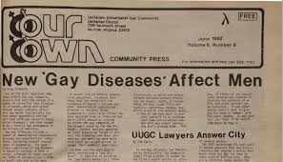
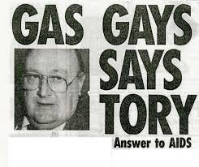
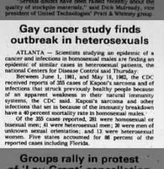
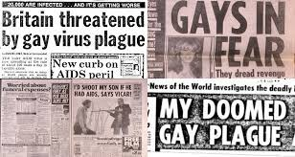
Notes:
Pathologising of homosexuality – AIDS epidemic.
We hopefully (and tragically) know the story well. HIV and AIDS. It very quickly became known as a gay disease and a gay cancer. Misinformation in the press, medical professionals not having the evidence to work with and advise upon, witnessed a worrying national response to HIV, AIDS and the LGBTQ+ community.
If we consider this alongside the timeline we’ve just looked at it, it’s clear to see that this has created a message that LGBTQ+ people are not only diseased, but that they pose a very real risk to the straight (can we read this at the time as superior) population.
All of this has culminated in our current situation in the UK. So what does the current healthcare landscape look like for members of the LGBTQ+ community and significantly, those who are responsible for caring for them (ie us!)

Slide 7
Let’s talk stats!
In Wales, 36% of HCPs reported never having received any form of face-to-face E&D training
Only 5% of patient-facing practitioners report receiving LGBTQ+ training (Chandler, 2020)
13% of Registered Nurses (RNs) feel able to meet the needs of their LGBTQ+ patients and service users (Stonewall, 2018)
44% of patient-facing staff have heard colleagues make negative remarks about LGBTQ+ patients / service users (Marie Curie, 2017)
57% of HCPs do not believe that someone’s sexual orientation / gender identity is relevant to a person’s health needs
NHS Long Term Plan (2019) – commitment to tackle health inequalities for LGBTQ+ people
WG’s recent publication of its LGBTQ+ Action Plan for Wales (2023)
Notes:
So unless you are part of the LGBTQ+ community in some form (be it an active member or an ally), then you may be unfamiliar with LGBTQ+ health inequalities and barriers to accessing health and social care services if you identify as LGBTQ+
This considered, the research really does speak for itself.
Of particular note on this slide is that:
- Only 13% of Registered Nurses feel able to meet the needs of their LGBTQ+ patients and services users
And then perhaps linked to this that:
Nealy 60% of HCPs do not believe that someone’s sexual orientation and/or gender identity is relevant to a person’s health needs.
Another worthy point of note that isn’t on this slide, is that those RNs who do feel able to meet the needs of their LGBTQ+ patients, their confidence plummets quite significantly when having to provide palliative care to LGBTQ+ patients and falls further still if their patients are LGBTQ+ and in receipt of end-of-life care.
This is what has prompted my interest in LGBTQ+ end-of-life service provision and my hashtag of QueerPeopleDieToo
It’s not all doom and gloom though (I promise!) and I very much welcomed both the publication of the NHS Long Term Plan in 2019 and its commitment to tackle health inequalities and more recently the WG’s publication of its LGBTQ+ Action Plan for Wales where both education and healthcare service provision are integral to its strategic ambition and success.

Slide 8
More stats? Yeap!
LGBTQ+ patients and service users have a more negative experience of healthcare when compared to non-LGBTQ+ folk
40% of transgender respondents experience negative treatment when accessing healthcare
21% of patients note their healthcare need wasn’t met
18% of transgender patients received inappropriate curiosity
46% of LGBTQ+ patients did not feel comfortable disclosing their sexual orientation (fear of negative comeback → 9% who did ‘come out’ when accessing services noted their care markedly changed and their care worsened
(Government Equalities Office, 2018)
Notes:
Run through slide.

Slide 9
Is awareness training enough?
Does awareness training equate to competence?
© Pride Universe
Notes:
I would argue not. That’s not to say that awareness training doesn’t have its place – and I’ll agree with those who say ‘some form of training is better than none’ – absolutely and I couldn’t agree more. However, if we take time to digest the statistics on the previous slide, there is global recognition that RNs tend to not be able to practice cultural competence and congruence with their LGBTQ+ patients and there can be for a number of reasons (from not recognising the needs of queer patients and service users, to not feeling confident in providing supportive care, to fear of ‘getting it wrong’ and offending people.
That said though, this inability (and maybe resistance can lead to worrying health disparities and – more relevant for us as nurses – a suboptimal level of nursing when compared to non-LGBTQ+ patients and service users.
This a key area of my focus and as LGBTQ+ lead as the Healthcare Education Department, it is my responsibility to ensure that all of our student nurses receive indicative curriculum content that is gender-inclusive in its approach. I have championed this as “Nurse education with a queer slant” and welcome reports from HEIW (our commissioning body) and WG that they are excited to see how this will change healthcare landscapes in the coming years.

Slide 10
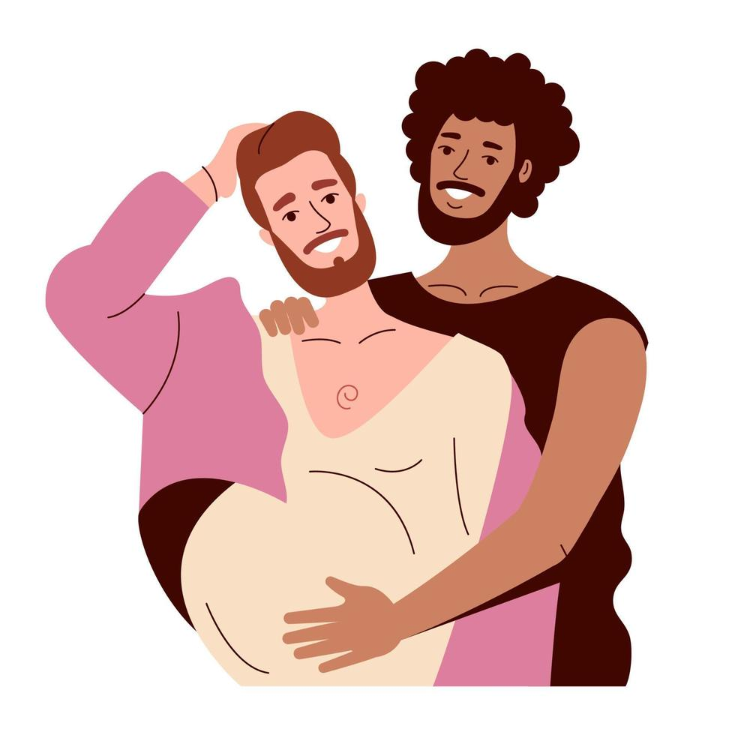
Experiential Learning: A hands-on approach
LGBTQ+ service users contribute to our curriculum content and influence its direction
Queer service user sessions – theory to practice approach
Visible across all years and programmes of study
Maternity Day
Transgender pregnancy – Specialist Midwives run bespoke sessions with our students focussing on transgender pregnancy and birth
Transgender people living with Dementia
Current research focus on session delivery
Notes:
We aren’t just providing lead lectures or what I sometimes to refer to as ‘chalk and talk’ sessions – we use a range of surface and deep approaches to our pedagogy, and central to this is our experiential learning approach that ensures our student nurses’ “live” the queer experience.
Run through and speak through the slides

Slide 11
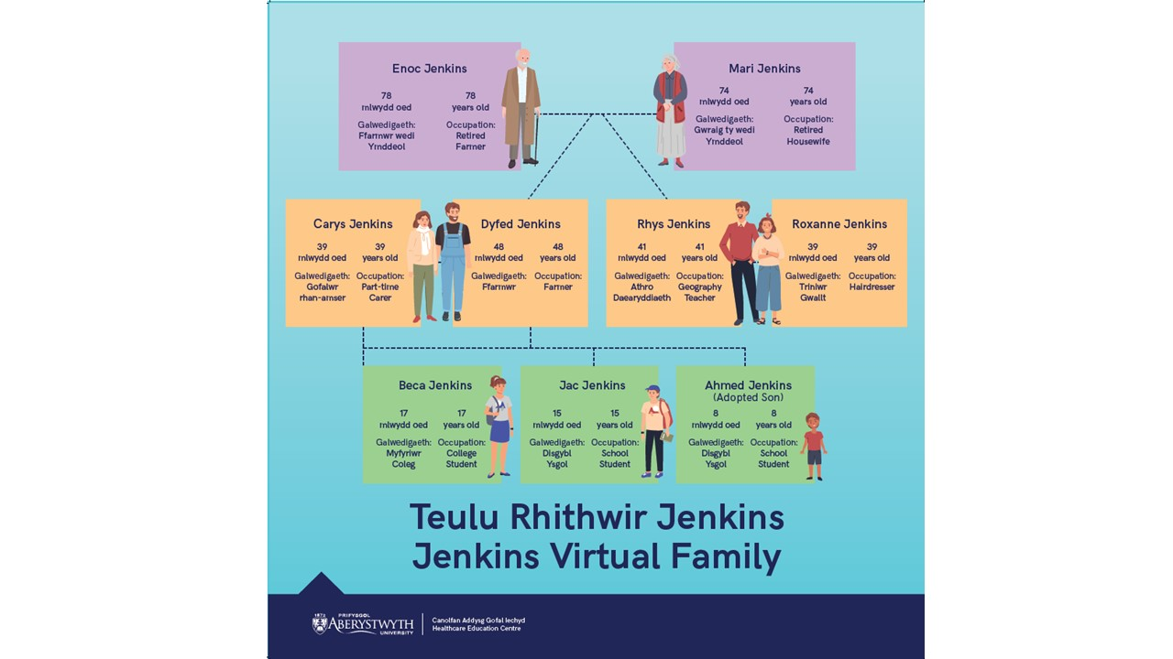
Experiential Learning: A hands-on approach
Teulu Rhithwir Jenkins | Jenkins Virtual Family
Jac Jenkins
Gender Fluid → LGBTQ+ Sexual Health Services
As Jac grows and develops, so too will their queer identity and students will be required to adapt their nursing approaches to them
Jac is also going to take increased sexual health risks and will require access to sexual health services – How will our students treat them? What challenges is Jac going to face?
Friend of the family – Josh is a trans man. He’ll miss his cervical screening check and will then become symptomatic and diagnosed with cervical cancer. MECC approaches and supporting him.

Slide 12
Case Studies and Debates
Transgender man with gynaecological concerns
(Including MECC approaches)
Transgender women with prostate concerns
(Including MECC approaches)
Gender neutral | Gender Fluid | Gender non-binary patients vs gender binary construct of healthcare
Notes:
At Aberystwyth, I teach a lot of nursing ethics and morals and, as such, this – as you can imagine – is an ideal place to foster debate and explore students’ emotions, thoughts and feeling around what can be quite complex case scenarios to unpick. So far, for example, students have discussed their ole as eventual nurse in these case studies, while we constantly refer them back to law and ethics, statutes and bills, and – of course – our NMC Code of Professional Conduct.

Slide 13
Let’s talk about SEX, baby!
Notes:
At Aberystwyth, I teach a lot of nursing ethics and morals and, as such, this – as you can imagine – is an ideal place to foster debate and explore students’ emotions, thoughts and feeling around what can be quite complex case scenarios to unpick. So far, for example, students have discussed their ole as eventual nurse in these case studies, while we constantly refer them back to law and ethics, statutes and bills, and – of course – our NMC Code of Professional Conduct.

Slide 14
Is there a welcome in the hillside?
Rural LGBTQ+ identities
Academically neglected area of research
Of the research available it is noted that:
Rural areas often create greater visibility for LGBTQ+ people
Rural areas contain fewer supports and alternatives in the face of discrimination
Rural populations are often less accepting of LGBTQ+ populations due to increased stigma and social isolation
(Henriquez & Ahmad, 2021)
Rural HCPs tend to reflect rural communities’ behaviours and attitudes (Patterson, et al., 2019)
Increased barriers exist in LGBTQ+ populations accessing equitable healthcare in rural communities
(Renner et al., 2021)
Notes:
Is there always a welcome in the hill side then?
Unfortunately not. There is international recognition that rural LGBTQ+ identity and (dis)engagement with healthcare services is an academically neglected area of research and I think this strengthens my argument for the need for indicative curricula content that responds to this grossly under represented education provision on nurse education programmes throughout the United Kingdom, but particularly here in Wales where we have higher levels of rural healthcare service provision.
Of note of the above slides –
Rurality creates greater visibility for LGBTQ+ people – that’s not meant to sound as positive as it does. What this actually means is that due to close-knit community dynamics, those who don’t fulfil the conventional ‘norm’ of that community are easily identifiable and – as such – at greater risk of prejudice, discrimination and mistreatment
Go through the points on the slide.
This then leads us to what we do at Aberystwyth with our indicative curriculum content.
Rural life serves to amplify the impacts of both acceptance and rejection.

Slide 15
Where does this leave LGBTQ+
Sexual Health Services?
How do we define Sexual Health?
“A state of physical, emotional, mental and social well-being in relation to sexuality, not merely the absence of disease, dysfunction or infirmity”
World Health Organisation, 2022
Sexual health is closely intertwined with and influenced by upstream political, legal, institutional, economic, sociocultural factors which provide the context to LGBTQ+ people’s lived experience
Notes:
Read above slides.
In some LGBTQ+ individuals, negative societal attitudes may be integrated into value systems and self-concepts → defined as internalised stigma.
LGBTQ+ individuals may experience abuse or violence for public displays of affection, and report higher levels of childhood bullying and trauma and poorer patient experiences when accessing healthcare. As we’ve seen in the previous slides.

Slide 16
Syndemic of inequalities affecting LGBTQ+ populations:
Sexual Health
Mental Health
Alcohol and substance use
Notes:
We are quite late to the party in the UK. In was only in 2017 that the NHS introduced routine collection of information about sexual orientations in primary care.
If we look at the inequalities affecting LGBTQ+ populations then, we note that it is in the areas of sexual health, mental health and substance use in which inequalities experienced by sexual minorities are more apparent. Together these areas form a syndemic interacting synergistically, each worsening vulnerability to the other others.
LGBTQ+ individuals have 2-3 times the risk of suicide, depression, anxiety and substance use disorders.

Slide 17
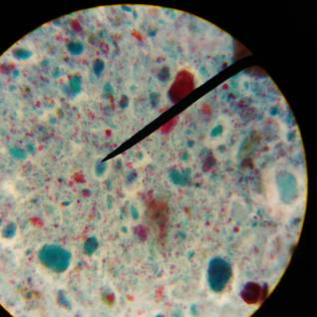
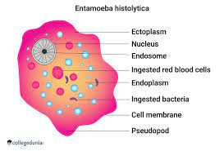
Sexual health in GBMSM
GBMSM are disproportionately affected by sexually transmitted infections (STIs).
2019, >80% of syphilis diagnoses and nearly half of gonorrhoea diagnoses were GBMSM
HIV rates falling as a result of either earlier diagnosis and the roll out of PrEP (HIV pre-exposure prophylaxis)
Sexually acquired enteric infections can be acquired through faecal contamination during anal or oral-anal sex (rimming)
Infections such as Hepatitis A, Giardia Intestinalis, Shigella species and Entamoeba are well documented in GBMSM
Notes:
Read above slides.
In some LGBTQ+ individuals, negative societal attitudes may be integrated into value systems and self-concepts → defined as internalised stigma.
LGBTQ+ individuals may experience abuse or violence for public displays of affection, and report higher levels of childhood bullying and trauma and poorer patient experiences when accessing healthcare. As we’ve seen in the previous slides.
Giardia Intestinalis - parasitic protozoan microorganism of the genus Giardia that colonizes the small intestine,
Shigella – Intestinal Infection
Entamoeba - Entamoeba histolytica, which is spread through human faeces. Often there are no symptoms, but, sometimes it causes diarrhoea, nausea, and weight loss

Slide 18
Chemsex!
Use of inhalational nitrates (poppers)
Advice: Never co-administer phophodieserase-5 (PDE5)
(→ profound and sometimes fatal hypotension)
Chemsex associated with riskier behaving such as fisting, higher partner numbers and STIs (including Hep C and Shigella)
It is essential that those patients accessing sexual health services and who disclose Chemsex practices have access to specialist harm minimization information and signposting
Notes:
As nurses we have seen (and heard) it all!
One of my greatest passions from a clinician perspective is to have open, honest and frank conversations with our patients (MECC strategies and helping us to help you)

Slide 19
Transgender experiences of Sexual Health (and services)
Transgender people experience significant inequalities in health including violence and victimisation and significant barriers to accessing healthcare
Cultural competence distances transgender from sexual health services
Rates of STI and HIV infection are disproportionately high, with most research focusing on trans women.
HIV susceptibility is not uniformly distributed across transgender populations →
Low adherence to HIV PrEP in transgender people
Vaginal atrophy caused by testosterone use can render trans men biologically susceptible to acquiring HIV
Notes:
As nurses we have seen (and heard) it all!
One of my greatest passions from a clinician perspective is to have open, honest and frank conversations with our patients (MECC strategies and helping us to help you)

Slide 20
Lesbian and Bisexual women
Some studies have reported a lower incidence of STIs in women with female partners
Should still be offered appropriate sexual health advice and access
Bisexual women are more likely than heterosexual women to report recent sex with GBMSM
Chronic pelvic pain and cervical cancer are also higher in this populate
Female-to-female transmission of genital human papillomavirus (HPV) types associated with cervical cancers have been reported with high rate of HPY and cervical neoplasia are well documented with women with no sexual history with men
Cervical screening uptake is lower in lesbian and bisexual women

Slide 21
What can we do?
Notes:
At Aberystwyth, I teach a lot of nursing ethics and morals and, as such, this – as you can imagine – is an ideal place to foster debate and explore students’ emotions, thoughts and feeling around what can be quite complex case scenarios to unpick. So far, for example, students have discussed their ole as eventual nurse in these case studies, while we constantly refer them back to law and ethics, statutes and bills, and – of course – our NMC Code of Professional Conduct.

Slide 22
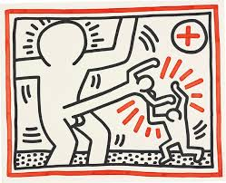
Environmental considerations and cultural competence
Creating confidential and welcoming environments
Cultural competence training essential to improve the quality of the consultation
Using appropriate language and non-judgemental attitudes
Sexual History taking and triage
MECC strategies and jargon busting (e.g. are you an insertive or receptive partner – what does that mean?)
Prevention and harm reduction (safeguarding concerns → Research confirms that higher risk-taking behaviours can be indicators of underlying vulnerabilities)
© Keith Haring
Notes:
At Aberystwyth, I teach a lot of nursing ethics and morals and, as such, this – as you can imagine – is an ideal place to foster debate and explore students’ emotions, thoughts and feeling around what can be quite complex case scenarios to unpick. So far, for example, students have discussed their ole as eventual nurse in these case studies, while we constantly refer them back to law and ethics, statutes and bills, and – of course – our NMC Code of Professional Conduct.

Slide 23
Diolch. Questions E: mat109@aber.ac.uk
Notes:
Open the floor to questions.

